Slide 1
Maths Parent Forum
Tuesday 5th December

Slide 2

White Rose
From September, the whole school has started using White Rose maths
This is a highly used scheme, which is used all across the UK
The school will now use White Rose books as well as their maths booklets

Slide 3
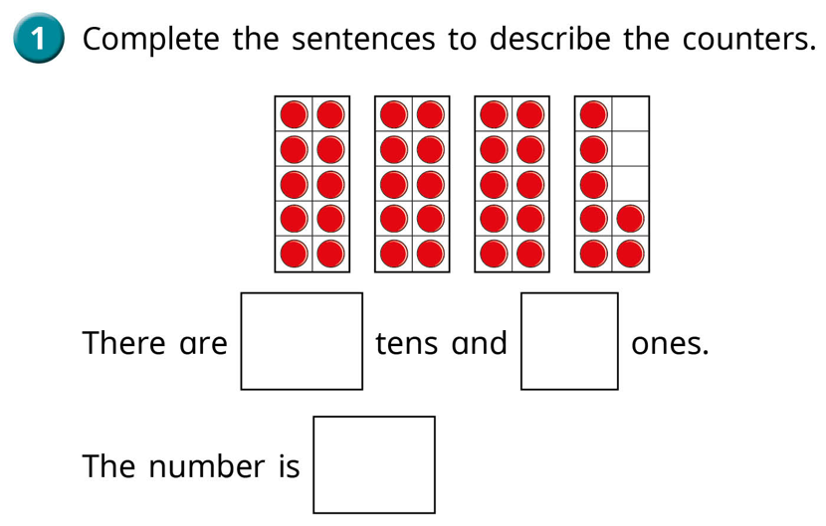
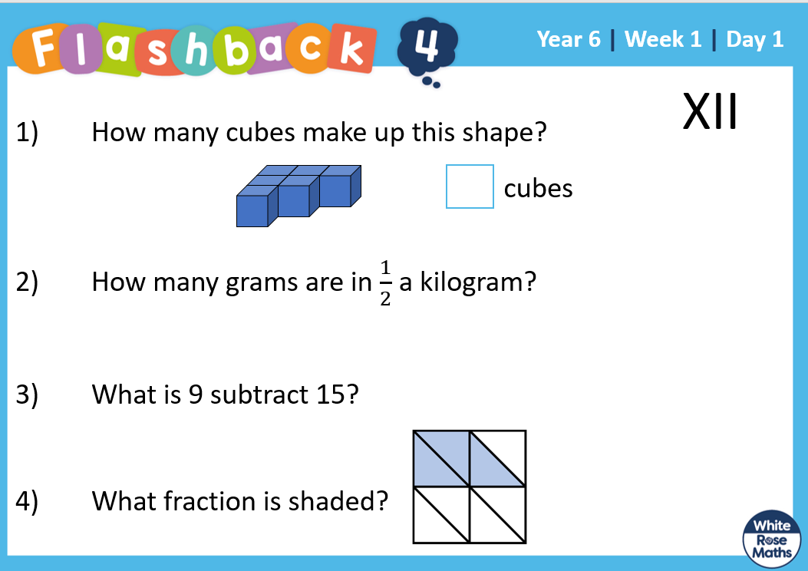
Why use White Rose?
Improve reasoning and understanding
Children will be given a range of questions that are put into different contexts to stretch their understanding
Concrete and pictorial learning resources
Daily recaps on previous learning
Clear progression of skills across year groups.
Increased emphasis on mental maths

Slide 4
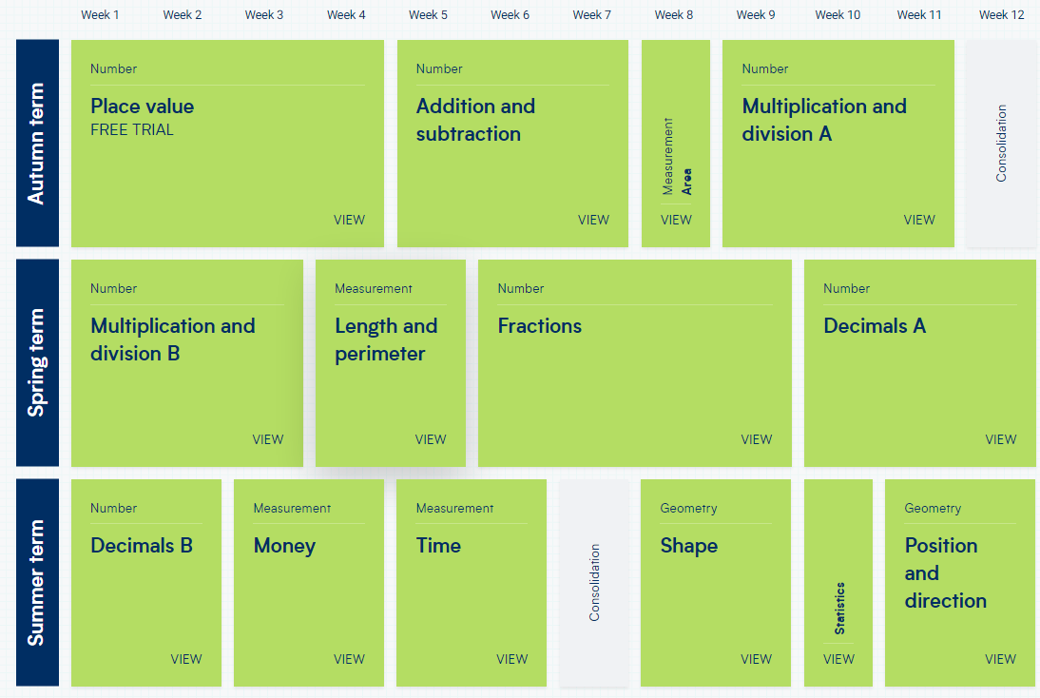

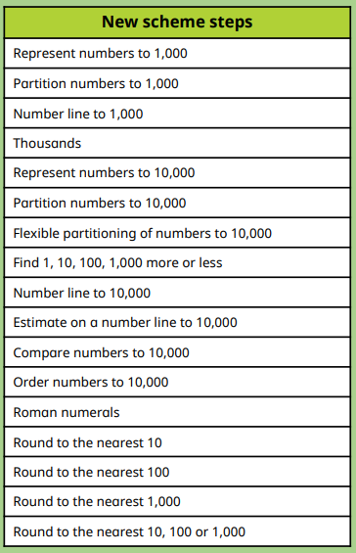
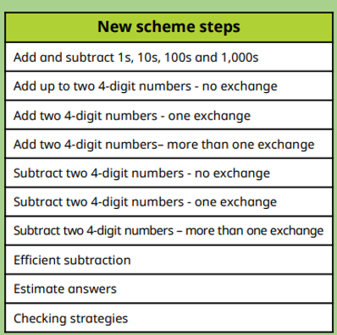
Progression of skills
Children will follow a sequence of lessons
Each Skill is broken down and then built back up
Once children have learnt the skill, we will then frequently recap the learning.
End of block assessment to check understanding

Slide 5
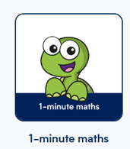
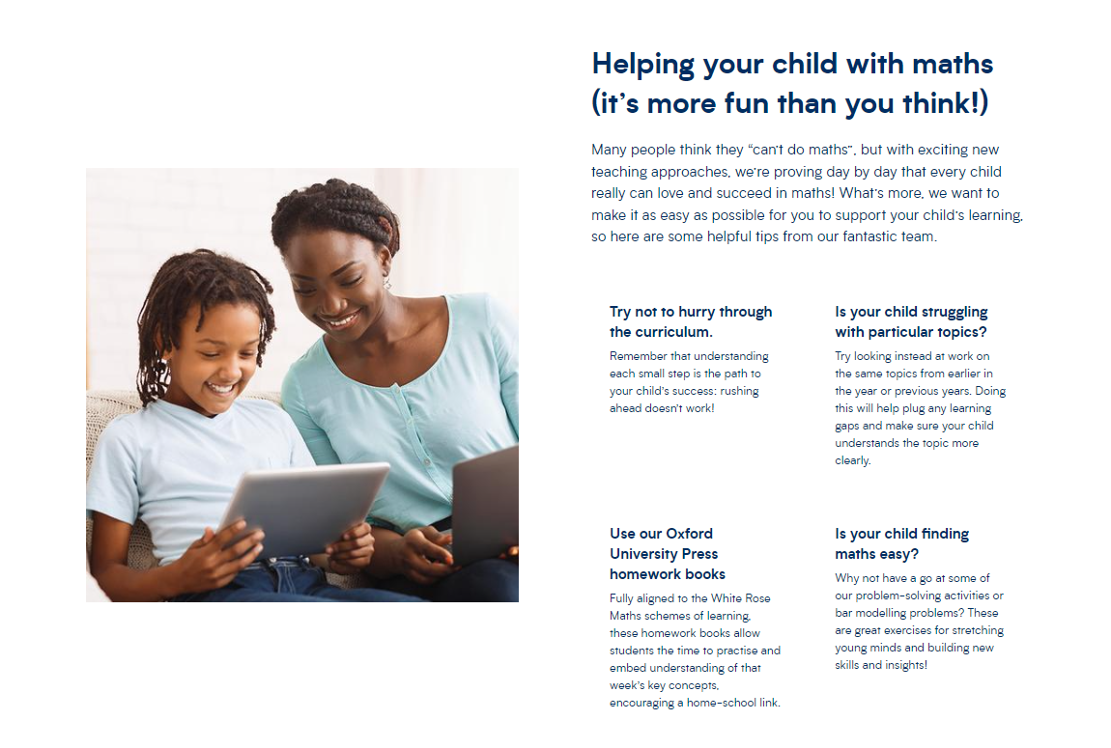
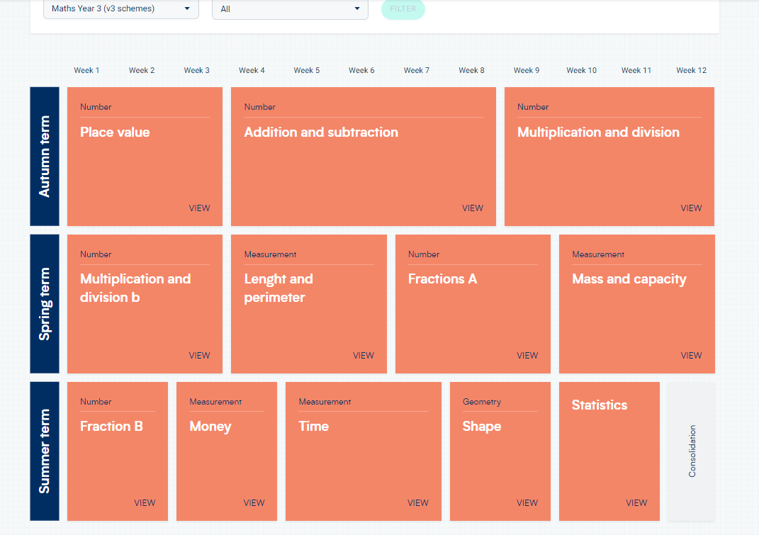
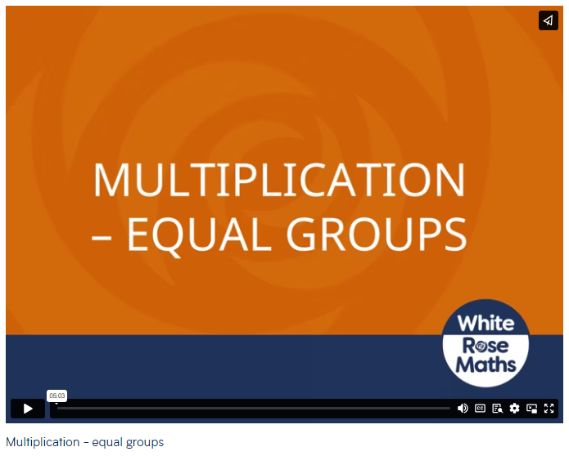
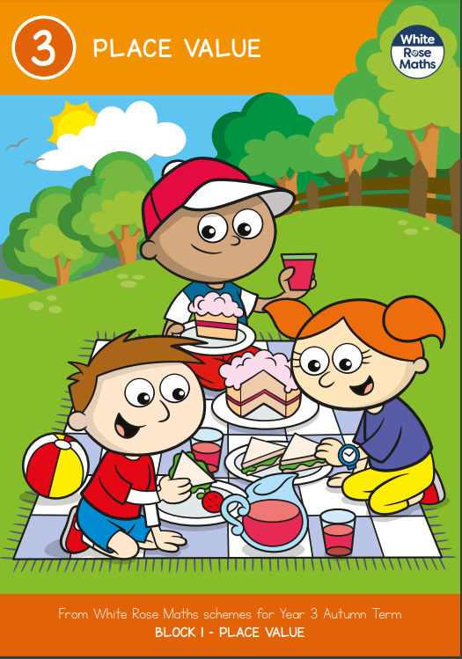
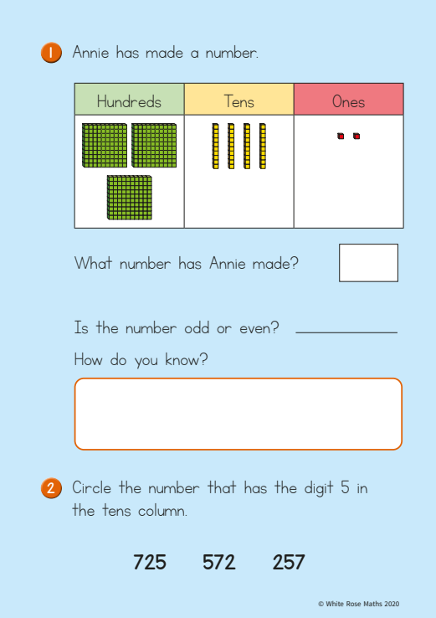
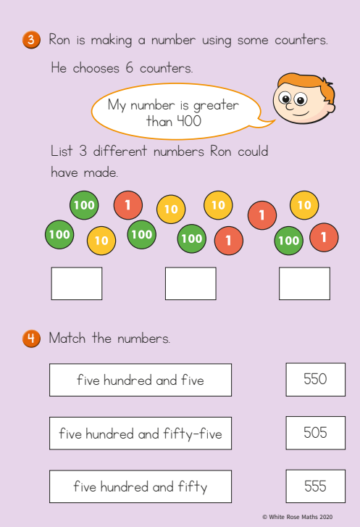
How can you use Whiterose at home?
3 areas
Advice and guidance
Outlines the scheme
Small steps
Online learning
Home learning
Outlines the blocks for
the year, click on a block
to get parent video
Free downloads
Workbooks to support and
consolidate learning in
school.
Free App
Support for all four operations and subitising
All this can be accessed via the following link
https://whiteroseeducation.com

Slide 6
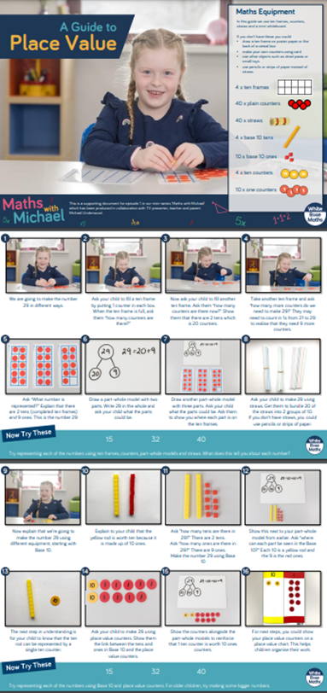

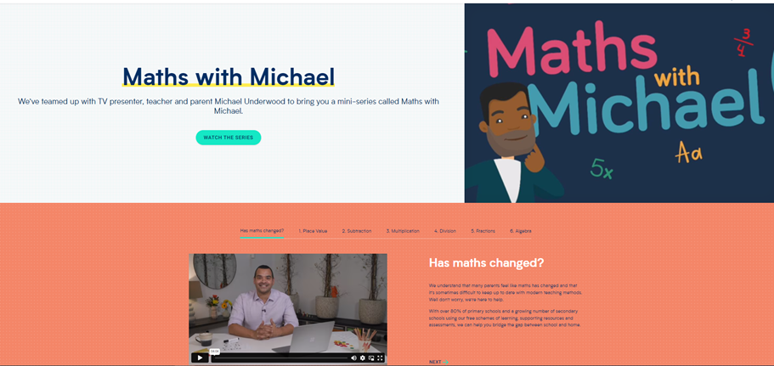
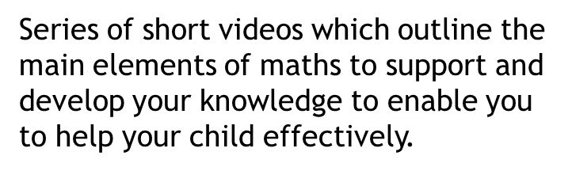

https://whiteroseeducation.com

