Slide 1
Welcome to the Parent Forum for phonics, reading and spelling
The next Parent Forum will be about maths on 5th October

Slide 2
Our Purpose:
Inform you
Show you resources
Answer questions
Make this available for all our parents to access
Introductions…

Slide 4
First important step towards reading and writing
Learning what the sounds say on their own
Blending sounds in words
This is called ‘synthetic phonics’ and research has shown this is the best method for teaching reading
44 sounds in the English language
Some sounds are represented by one letter ‘t’ and some by two or more ‘ck’ ‘air’
Children are taught the first sounds
Then they are matched to letters
Finally how to use the letter sounds for reading and spelling

Slide 5
Sounds are taught in a special order designed so children can start reading complete words as soon as possible
s a t p i n m d g o c k/ck e u r h b f l j v w x y z qu ch sh th ng ai ee igh/ie oa oo (short) oo (long) ar or ur/er ow/ou oi air ear ure
Sounds are revised then new ones taught
Children are shown how to ‘blend’ or sound out words using the sounds taught
We use a few different approaches to teaching phonics
Letters and Sounds
Jolly Phonics
Read, Write Inc

Slide 7
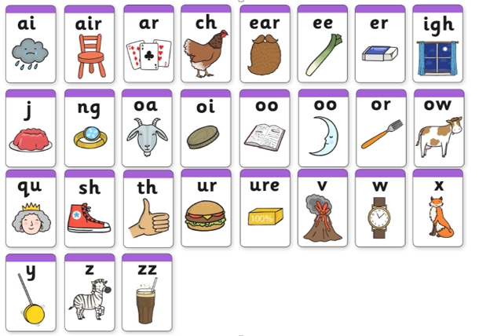

Slide 9
What can you do to help?
Practice sounds that are sent home using the methods your teacher has suggested
Log on to Phonics Play for interactive games and advice
Ask your class teacher if you are unsure how to pronounce sounds or how to support your child
Read unfamiliar books so children have to sound out
Phonic Screening Check at the end of Year 1
Tells us children who can use the phonics skills they’ve learnt and identifies children who need any additional support
40 words and non-words
http://www.theschoolrun.com/system/files/download_files/phonics_sounds4.swf

