Slide 1
Parent Workshop computing & Online safety
Monday 22nd January 2018
www.oakridgeschoolsfederation.co.uk
Twitter - @OakridgeFed

Slide 2
Computing Parent Forum
How is Computing/I.C.T taught at Oakridge?
Online safety
Useful information – school website and Twitter

Slide 3
Ict mark accreditation – march 2017

Slide 4
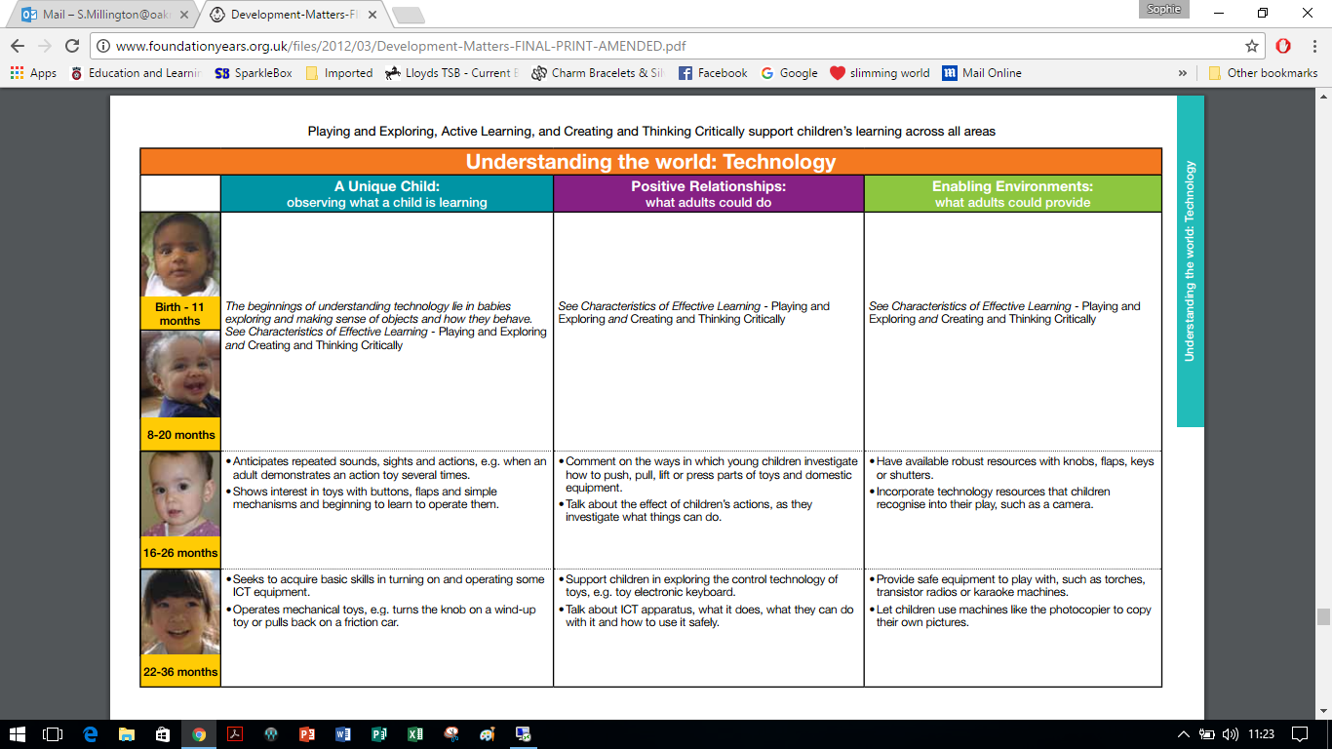
Foundation Stage

Slide 5
Foundation stage
Computing/I.C.T is taught through continuous provision within the classroom
Children are encouraged to use a variety of equipment including: Desktop computers, laptops, iPads, programmable robots and toys, remote controlled cars, recording technology and many more!
How you can help at home?
Showing children have to turn on/off different computers particularly desktop and laptops.
Discussions about using computers in the wider world.

Slide 6
Foundation stage
Tapestry
https://tapestryjournal.com/

Slide 7
Key Stage 1 national curriculum objectives:
understand what algorithms are; how they are implemented as programs on digital devices; and that programs execute by following precise and unambiguous instructions
create and debug simple programs
use logical reasoning to predict the behaviour of simple programs
use technology purposefully to create, organise, store, manipulate and retrieve digital content
recognise common uses of information technology beyond school
use technology safely and respectfully, keeping personal information private; identify where to go for help and support when they have concerns about content or contact on the internet or other online technologies.

Slide 8
KEY STAGE 1
Using technology in the classroom
Using technology at home
How can you help at home?

Slide 9
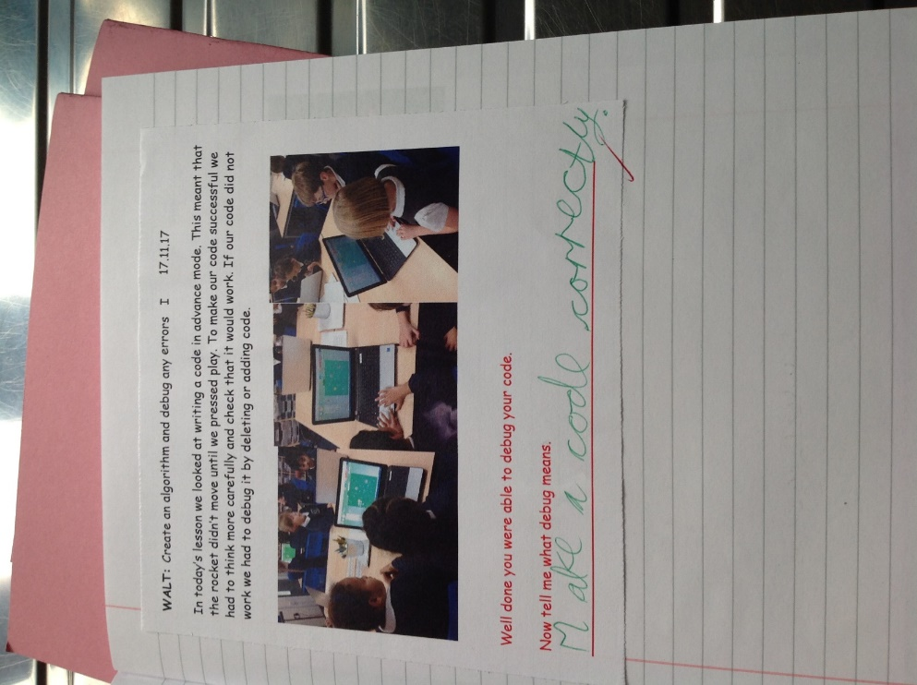
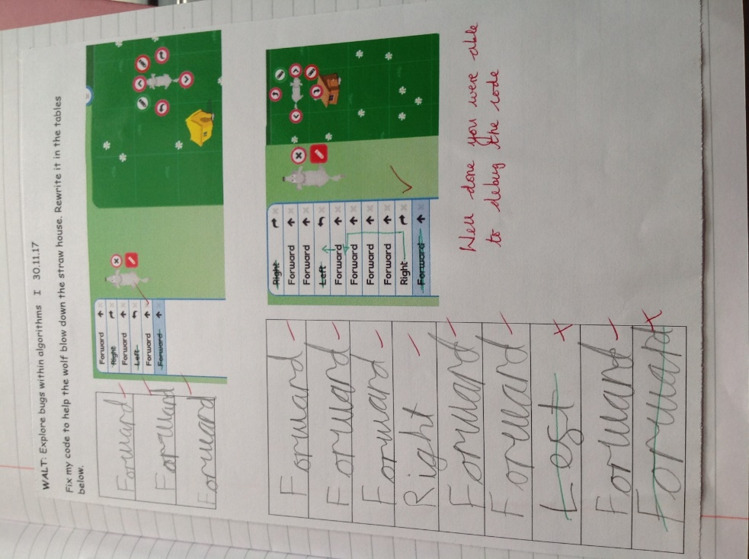
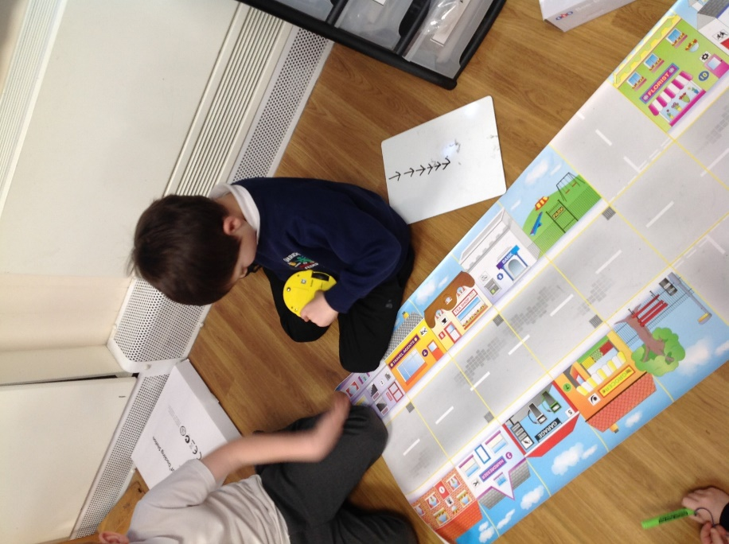
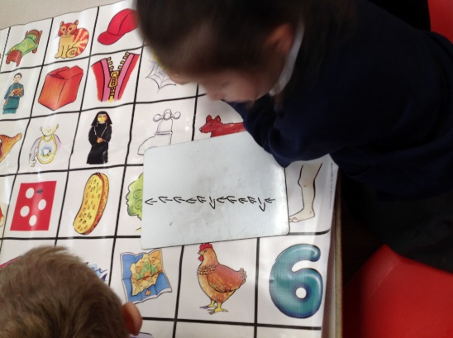

Slide 10
Key stage 2 national curriculum objectives:
design, write and debug programs that accomplish specific goals, including controlling or simulating physical systems; solve problems by decomposing them into smaller parts
use sequence, selection, and repetition in programs; work with variables and various forms of input and output
use logical reasoning to explain how some simple algorithms work and to detect and correct errors in algorithms and programs
understand computer networks including the internet; how they can provide multiple services, such as the world wide web; and the opportunities they offer for communication and collaboration

Slide 11
National curriculum continued:
use search technologies effectively, appreciate how results are selected and ranked, and be discerning in evaluating digital content
select, use and combine a variety of software (including internet services) on a range of digital devices to design and create a range of programs, systems and content that accomplish given goals, including collecting, analysing, evaluating and presenting data and information
use technology safely, respectfully and responsibly; recognise acceptable/unacceptable behaviour; identify a range of ways to report concerns about content and contact.

Slide 12
Key stage 2
Using technology in the classroom
Using technology at home
How can you help at home?

Slide 13
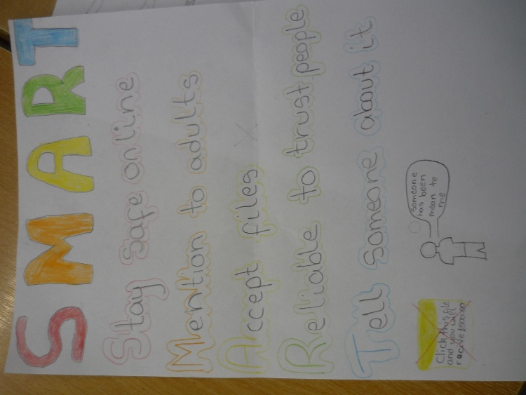

Slide 14
Using AN IPAD IN THE CLASSROOM

Slide 15
Online safety
“70% of parents feel that their children know more about the internet than they do”
(Ofcom Media Literacy 2011)

Slide 16
ONLINE SAFETY
71% of young generations say they are concerned about cyberbullying
There is online bullying among youth between the ages of 8-17 worldwide.
Over one million children were harassed, threatend or subjected to other forms of cyberbullying through Social Media during the past year.

Slide 17
ONLINE SAFETY

Slide 18
ONLINE SAFETY – THE SCHOOL APPROACH
Safe: keeping personal information safe
Meeting: online friends are strangers
Accepting: be aware of viruses
Reliable: information may be untrue
Tell: inform an adult

Slide 19
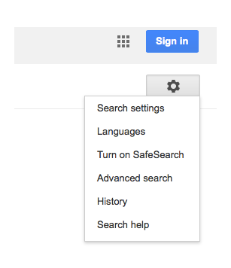
What to do at home?
Check history of websites children have viewed
Turn on Safe Search in Google

Slide 20
GAMING

Slide 21
YouTube
You can register for a YouTube account from the age of 13 in the UK. Because YouTube is owned by Google, the site uses a Google accounts sign-in system to give you access to all their products such as YouTube, Gmail and Google+.
When registering, if a date of birth is entered that indicates you are below the age of 13, account registration will be disabled. Some videos on YouTube have an adult age restriction if YouTube deems them to contain potentially inappropriate content. These are only available to registered users who claim to be 18 years old or older.
However, you do not have to register with YouTube to view most videos. If your child is using YouTube and is not registered, a warning sign will appear for any video flagged as age-restricted, and will ask the user to register to confirm their age. As with most other social media platforms, YouTube does not verify the age entered.

Slide 22
YouTube
Several features of YouTube could present as potential risks to children and young people:
Viewing content
Sharing of information and images
Connecting to other users they do not know
Cyber bullying
YouTube hosts content you may deem inappropriate for your children, including videos that containing violence, scenes of a sexual nature or bad language. YouTube has ‘community guidelines’ about what content should and shouldn’t be uploaded and states that any video content that breaks these guidelines will be removed or become age-restricted.
These can be found at: https://www.youtube.com/yt/policyandsafety/en-GB/communityguidelines.html

Slide 23
Encourage use of child friendly search engines e.g. Yahooligans
Use safe search apps on an iPhone and iPad e.g. K9 browser.
Think about when your child needs a mobile phone. Contact the provider to put restrictions on usage.
For older children, encourage discussions around the appropriateness of some apps and what steps they can take in order to be SMART users of technology.

Slide 24
Make sure you use a firewall and have anti-virus software
Set up a family email for websites children access
Encourage children to not use a nickname on sites and not share personal information

Slide 25
GUIDELINES FOR SETTING UP AN ACCOUNT:
Build a profile with your child. Discuss what personal information to share.
Set a strong password.
Become your child’s friend.
Discuss which photos are appropriate to post and how they can be misused.
Explain that friends should be people they know.
Set strong privacy settings to friends only.

Slide 26
FOR MORE INFORMATION …
https://www.ceop.police.uk/safety-centre/
http://www.parentscentre.gov.uk/
www.thinkuknow.com
http://www.getnetwise.org/
http://www.childnet-int.org/
http://www.bbc.co.uk/webwise/
http://www.iwf.org.uk/
http://www.internetmatters.org/age-guides/videos.html
http://facebook.com/safety

Slide 27
Useful safe websites for links across the curriculum, including games and general resources:
http://www.bbc.co.uk/schools/parents/
http://www.topmarks.co.uk/
http://www.woodlands-junior.kent.sch.uk/Games/
http://www.bgfl.org/bgfl/15.cfm?s=15&p=251,index
http://www.bbc.co.uk/schools/

Slide 28
Thank you
Any questions?
www.oakridgeschoolsfederation.co.uk

