Slide 1
Science at Oakridge Federation
Parent Forum
Wednesday 14th March 2018

Slide 2
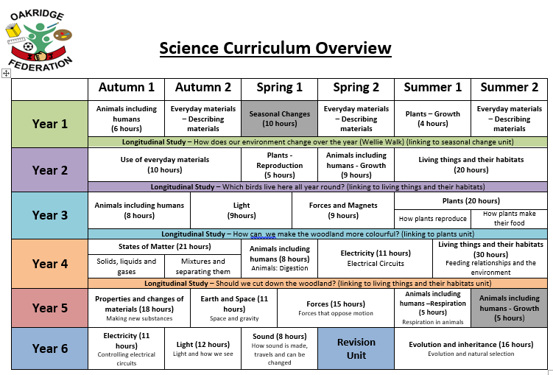
How is the curriculum organised?
As a school we follow the ‘Hampshire Model for Science’.
Our curriculum is progressive allowing children to develop and build on their prior learning.
Some topics are only covered periodically

Slide 3
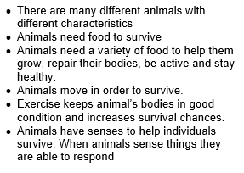
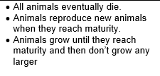
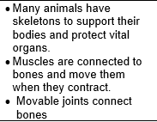
The Learning Journey
Topics are broken down into ‘Key Ideas’
For example in the topic of ‘Animals including Humans’
Year 1
Year 2
Year 3

Slide 4
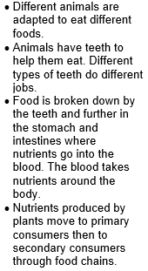
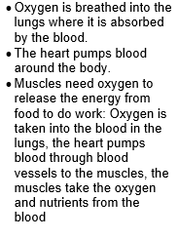
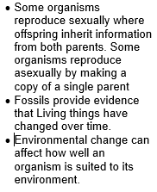
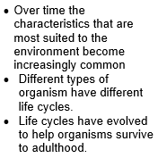
The Learning Journey
Year 4
Year 5
Year 6

Slide 5
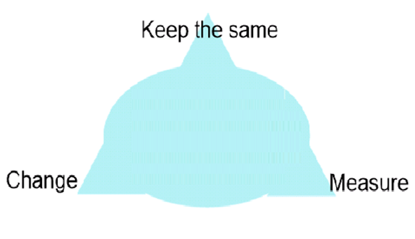
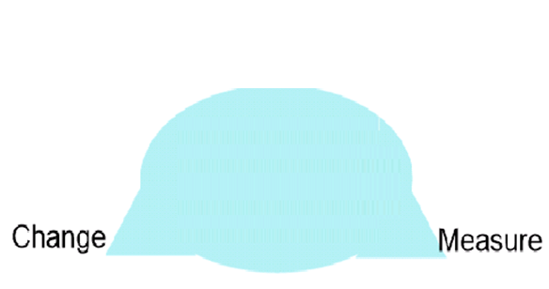
What does learning look like?
In class science is taught in a practical way allowing children to investigate as many concepts as possible. (where possible and safe)
Children are encouraged to plan their investigations to develop their scientific working.
Year 1&2 work on developing their understanding of cause and affect.
Year 3&4 work on developing their understanding of how to make their investigations fair.
Year 5&6 work on developing their understanding of results and how these can be different.

Slide 6

To test or not to test…
At Oakridge we DO NOT believe in testing the children and their scientific understanding.
Instead we use assessment in lessons to make judgements and ensure all children are keeping up with the learning.
Using these judgements we adapt and change lessons to ensure all children develop their understanding.
The Department for Education does every 2 years sample a selection of schools through testing children’s understanding.
These results are NOT reported parents or schools.

Slide 7
Added Extras…
Year 4 enjoyed learning about materials are made from different densities meaning they can be identified by the distance a can rolls.
Year 5 and 6 worked with the Vyne School exploring chemical reactions to make pop rockets. They also explored how some liquids have different densities.
Science Day (24th November 2017)
Year R and Year 1 explored bones and how they different in different animals. They also enjoyed learning about Newton's third law of motion!
Year 2 worked with Everest Community Academy to make slime exploring the properties of materials.
Year 3 work with Everest Community Academy to split light and make rainbows.
As part of our transition work with local secondary schools we have children who go and use the science laboratories. Year 5 will go to Everest Community Academy on Wednesday 21st March.

Slide 8

How can you help your child?
Discuss with your child basic scientific concepts.
Encourage them to ask why questions e.g. why do we get day and night.
Talk to them about what they have learnt in science. Use this to ask them other questions and correct them if they are wrong.
Encourage them to explore and find things out themselves safely.

Slide 9
Purpose of Longitudinal Studies
A high-quality science education provides the foundations for understanding the world through the specific disciplines of biology, chemistry and physics. Science has changed our lives and is vital to the world’s future prosperity, and all pupils should be taught essential aspects of the knowledge, methods, processes and uses of science. Through building up a body of key foundational knowledge and concepts, pupils should be encouraged to recognise the power of rational explanation and develop a sense of excitement and curiosity about natural phenomena. They should be encouraged to understand how science can be used to explain what is occurring, predict how things will behave, and analyse causes.
- National Curriculum, 2014

Slide 10
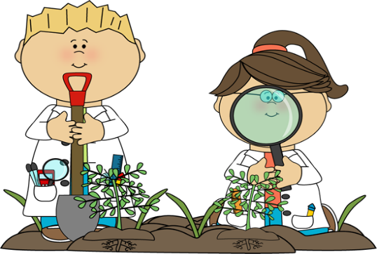
Longitudinal Study
Started this year and has been very successful
Years 1 to 4 take part in longitudinal studies
Children are given a question to base their year long study on
Learning is revisited consistently over the year
New data is collected and compared with old data
At the end of the year children will be able to draw upon all of their learning and write a conclusion which is based on their own findings

Slide 11
What does this look like?
Year 1 – ‘What changes in the playground over the 4 seasons?’
Year 2 – ‘Which birds live here all year round?’
Year 3 – ‘We want to make the wooded area more colourful, what flowers would grow there?’
Year 4 – ‘What would be the effect of cutting down the woodland? Should we do it?’

Slide 12
Year 1 Examples of Work

Slide 13
Year 2 Examples of Work

Slide 14
Year 3 Examples of Work

Slide 15
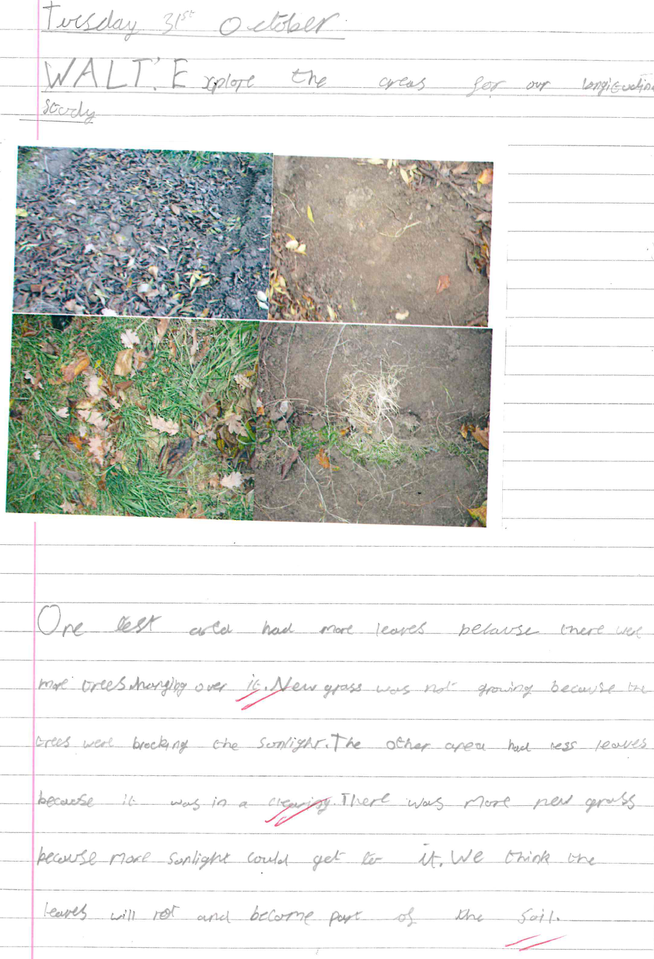
Year 4 Examples of Work

Slide 16
Questions?

