Slide 1
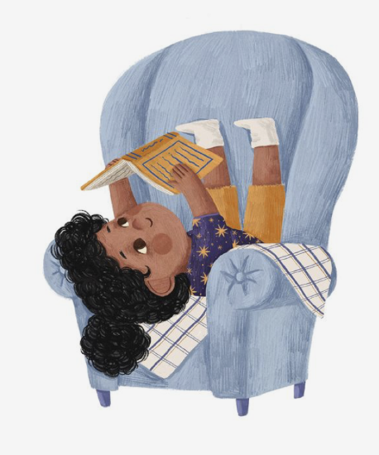
Year 1 Open Morning
Reading and phonics
Tuesday 27th September 2022
Harriet Cryer- English lead

Slide 2
On the agenda…
Early reading
Phonics
Phonics screening
Books, books books

Slide 3
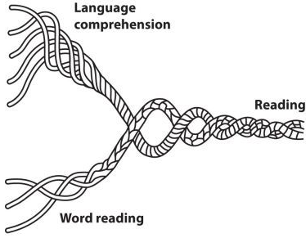
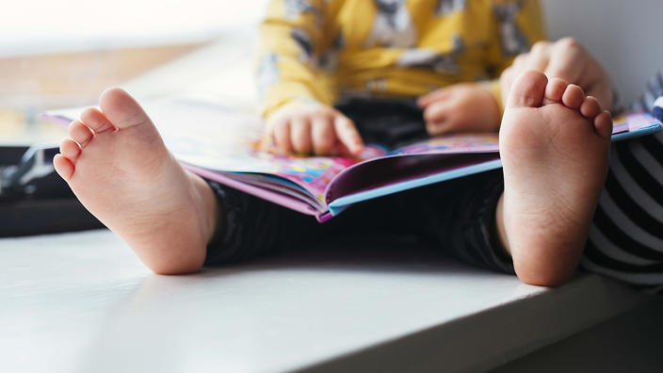
Early reading
Notes:
For those of you who came to the phonics parent forum last September, you may remember me referring to this ‘reading rope’. I promise not to bog you down with a load of theory, but I think this is a really good visual model for explaining the complex skill of reading. Essentially a successful reader is able to do 2 things at once. Number 1: read the words on a page and number 2: make sense of what is being said.
At the moment, most of your children are not able to do both of these things at once. The two ‘strands’ as it were, are not yet entwined. As an early reader, they are still trying to make sense of the complex code that allows us to read a word. This means most of our brain power is spent looking at the letters in the word and trying to work out what they mean. Until children can do this automatically, they are less likely to be able to make sense of what is being said. This of course is where the enjoyment lies so…

Slide 4
Keeping the balance…
Notes:
Between us- you at home and us at school, our aim is to keep that balance. We want to support our children in learning to read while at the same time never allowing them to lose sight of the fact that reading is pleasurable.
More importantly, reading and books will take them to worlds they have never visited and introduce them to characters they may never otherwise have met. With this comes important lessons about the world and the people who live in it. Emotional literacy, after all, is just as important.

Slide 5
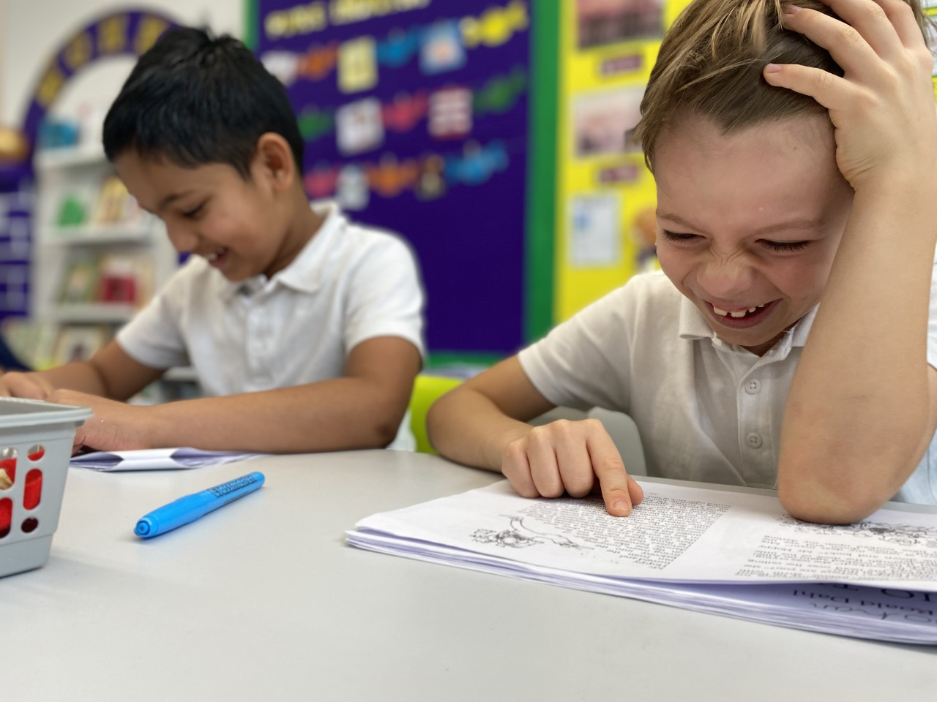
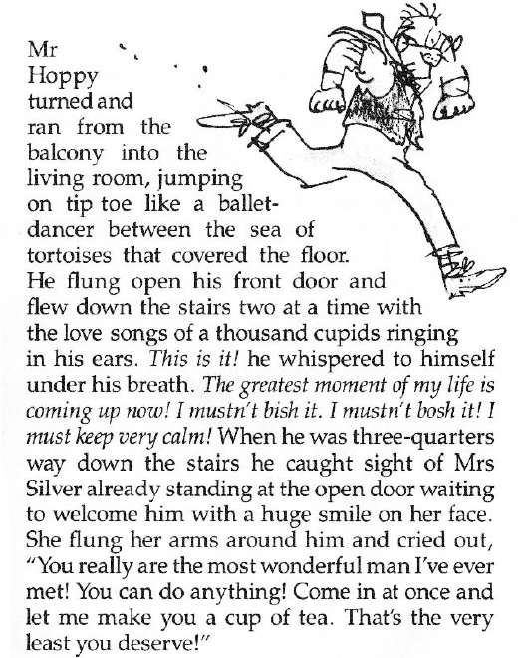
Notes:
So..this is what we’re aiming for. These are year 2 children for whom those 2 strands are now entwined. They can read with fluency and, as you can see from their faces, are now able to really understand and appreciate the hilarity in what they are reading.
We want to help children acquire this complex skill of decoding as quickly as possible because once they are able to read with fluency, they will be free to truly understand and enjoy the story, fact or message being communicated.
This is epitomised in this picture: these are two children in year 2, reading the part Roald Dahl’s Esiot Trot where Mr Hoppy ‘jumps on tiptoes like a ballet dancer’ through a sea of tortoises because his master plan to win the heart of his neighbour, Mrs Silver, has finally come into fruition. The smiles and laughter were totally genuine because they were able to appreciate the hilarity in that imagery.
For this child, those 2 strands we saw at the beginning have become entwined.

Slide 6
Decoding… (learning to read words)
To be able to read, children need to be taught an efficient strategy. That strategy is phonics.
Children should use phonics as the route to decode (read) words.
Notes:
So if that’s the aim… how are we getting there?
That word reading part comes first. The ‘decoding’. The government dictates that this be taught through something called ‘phonics’. Every school is now advised to follow a validated ‘SSP’- systematic, synthetic phonics programme.
So you’ll be pleased to know, the word reading part, is predominantly on us- the schools and its teachers. More than ever, the emphasis is on a totally consistent approach in every sense of the word with the children learning their phonics in the exact same way with the exact same mantras, following the exact same progression from the minute they start the programme to the end.

Slide 7
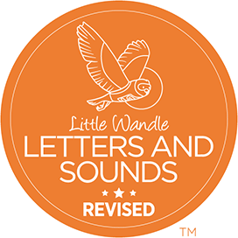
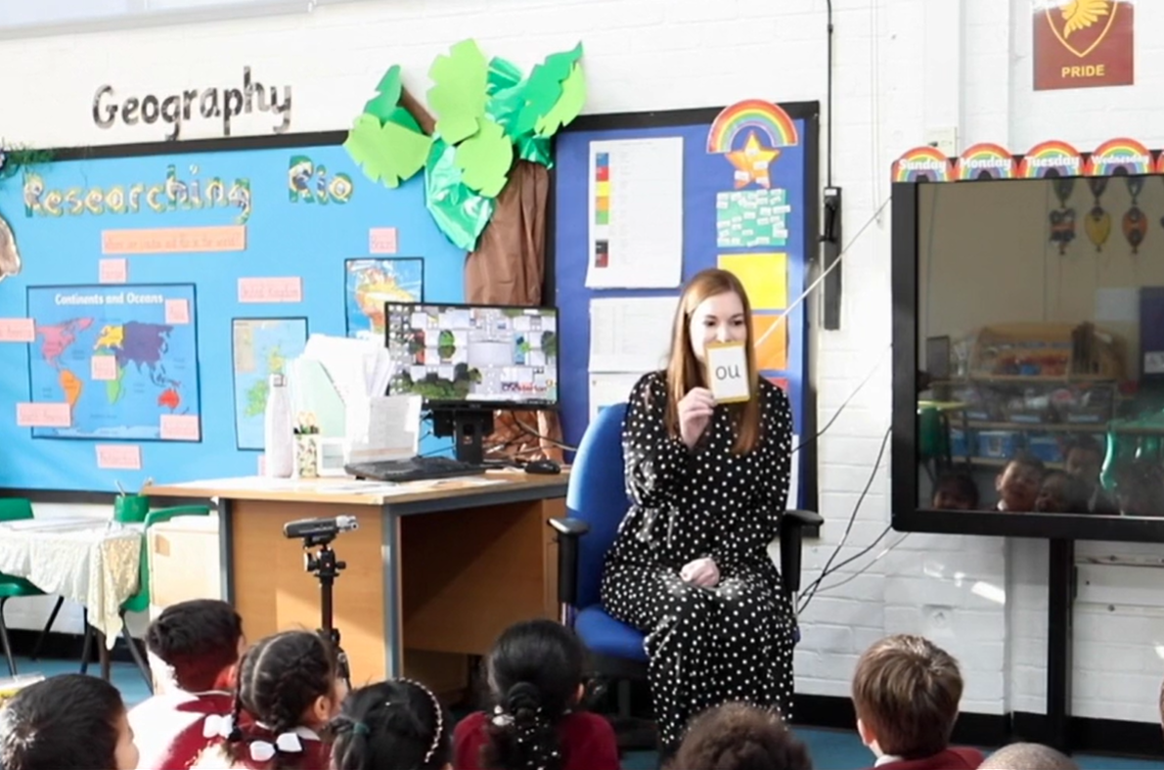
How we teach phonics
Notes:
Since September 2021, we have been following the Little Wandle Letters and Sounds Revised scheme.

Slide 8
So what is phonics?
seat
s
t
ea
Spoken sounds (phonemes)…
…can be represented by letters to form words

Slide 9
seat
1
2
3
In the word ‘seat’ we can hear 3 phonemes (sounds).
Each phoneme is represented by a ‘grapheme’
A grapheme is a letter or a combination of letters that represent one sound.

Slide 10
Terminology
s w e e t s
n i g h t
A grapheme with 2 letters is called a digraph
A grapheme with 3 letters is called a trigraph

Slide 11
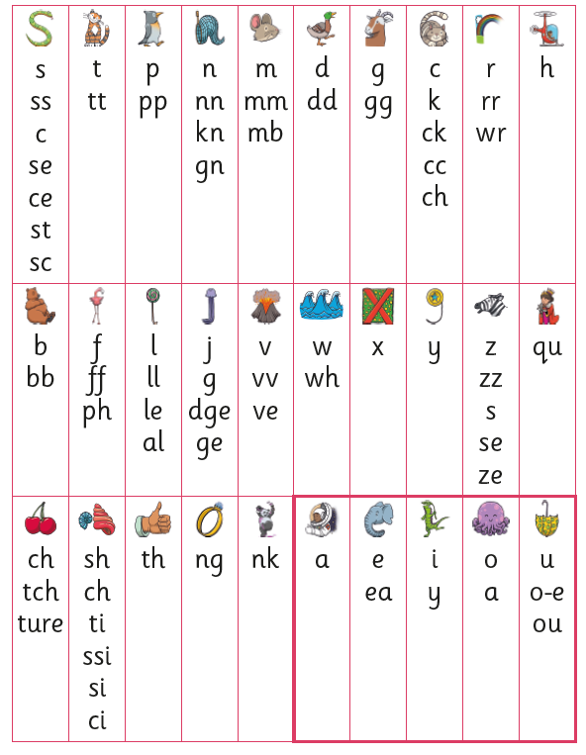
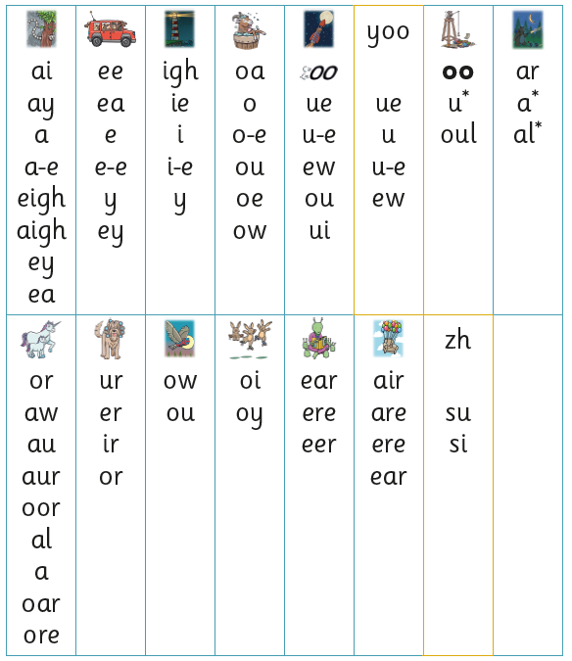
Complicated stuff…
There are 45 sounds for children to learn…
…but each sound has multiple graphemes.

Slide 12
For example…
green
carry
sea
donkey
…the /ee/ sound can correspond to 6 graphemes
relax
athlete

Slide 13
A note on tricky words…
my
they
she
was
Notes:
There are of course some words that we need to teach by sight because they contain unusual graphemes that the children won’t learn until a bit later on in the programme. These are the type of words that we are using all the time in our spoken language such as.
We teach the tricky words progressively throughout the phonics programme, discussing with children why they are tricky and providing plenty of opportunities for them to learn them and recognise them automatically by sight. This is something you could help your children with at home and a list of the tricky words and where they are taught is included in the progression, which is in your pack.

Slide 14
Phonics teaching is…
Teaching children the sounds
Progressively teaching the corresponding graphemes
Teaching children to recognise the sounds within words so that they can segment and then blend the word in order to read it
Notes:
In a nutshell…

Slide 15
What does this look like in year 1?
Daily 30 minute whole class phonics lessons in Reception and Year 1
3 times weekly reading practice sessions in a small group
Regular catch-up sessions for children who fall behind
(the book they read in these sessions will be the one they can also practise at home)

Slide 16
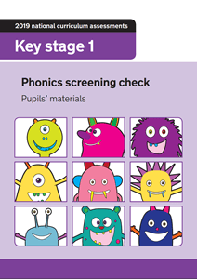
Phonics screening
It takes place at the end of Year 1 when the children should have completed the phonics programme
Any children who do not pass the phonics screening will receive additional support with their phonics in year 2
The phonics screening test is a government requirement

Slide 17
Let’s talk books…
2 ‘types’ of book
A reading practice book (a learn to read book)
A share with me book (or ‘reading for pleasure book’)
Notes:
Okay…let’s talk books.
I will say right from the outset: I will be talking about 2 types of book. Allow me to remind you of the scales we talked about earlier.
Essentially…there are the type of books that will help your child to progress with their independent reading. We will call these ‘reading practice books’. These are books closely matched to your child’s phonic ability.
Then there are reading for pleasure books. These are books we wouldn’t necessarily expect your child to read at home but that shouldn’t stop them enjoying them. It just means they need to share them with someone who could support them with the reading. The purpose of this book isn’t to unpick the letters the try and read the words. The purpose of this type of books is ENJOYMENT. Enjoy the story, enjoy the pictures, enjoy the characters. Talk about plot, make predictions about what might happen next- enjoy, enjoy, enjoy.

Slide 18
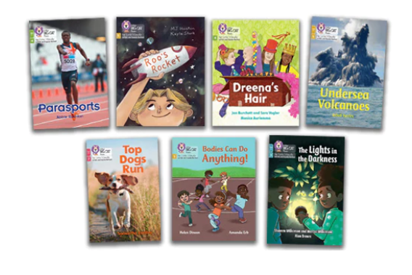
Reading practice books…
Notes:
Let’s talk about these reading practice books:
GET THE BOOK OUT
Of course, a key part of learning phonics, is the opportunity to apply the skill reading actual books…this is the aim of the game after all.
This means the children need to have books that are totally decodable. How disheartening would it be, learning this brilliant formula for reading words and then finding it doesn’t actually work when you put it into practise…
As a school we have spent a huge amount of money on a brand new set of books that are completely decodable and matched to our Little Wandle phonics scheme. (Show the parents a set of books)
Little Wandle suggests that once they have read this book in their reading practice sessions, they can bring it home to read it with you. At this point we would expect them to be reading it fluently, thus removing any pressure from you to have to teach them any phonics!
As these cost so much money, we haven’t been allowing the children to take these books home.
Instead, they have a username and password to an online platform:

Slide 19
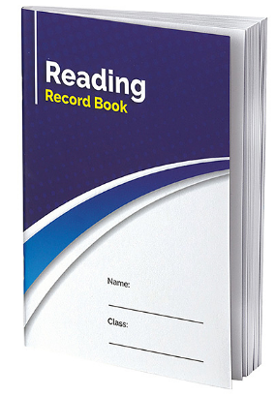
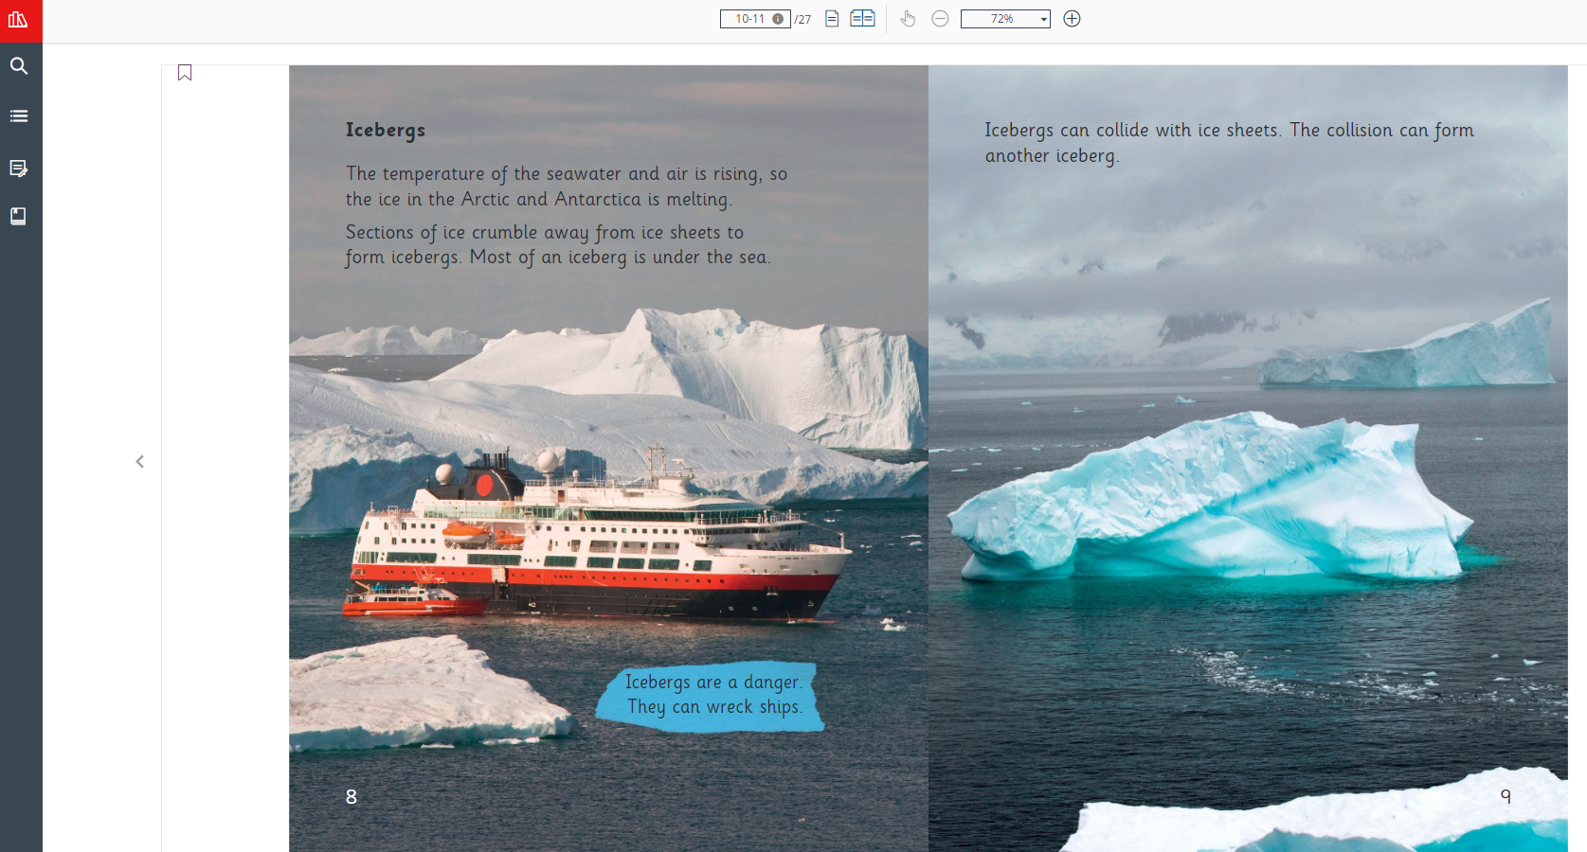
Collins e-books
and some happy news…
Notes:
You might recall that previously, the only way we have been able to allow the children to read their phonics books at home is via the online platform. Their login can be found in their reading diary- and this is still the case. However, we know many of you have expressed concerns about this and have queried the lack of a physical book to read. To level with you, the main reason behind this is because we have a limited budget and a set number of books. If the children start taking them home, invariably they won’t all come back, thus jeopardising the availability of resources for our guided sessions. This was never intended to be a long term situation and unfortunately was just part and parcel of starting a brand new scheme.
There is some good news though…this year we are going to start allowing these books to go home! So once your child has shared their phonics book in the reading practice session, they will then be given the chance to bring it home and share it with you. Your child’s class teacher will sign it out, and The idea is that by this point, they will be reading it with fluency, and thus there shouldn’t be any pressure on you to do any phonics teaching!
(Show parents how to login and give a quick demo)
We know that many of you have expressed concerns about your children not bringing home levelled books to read. Those of you who have had children in the school in previous years may be wondering where their ‘colour band’ book is. This is because the government advocates that the books children use to ‘learn to read’ are 100% decodable. This means they only contain words that can be read by applying their current level of phonics knowledge because this is deemed the most efficient and fool-proof method of learning to read. If children learn, for example, to rely on picture cues, this is not going to support them when they come to read books that do not contain pictures. We want them to acquire a strategy with longevity, that will work for any unfamiliar word they may come across in any context.

Slide 20
A big BUT…
Please ensure the books are returned.
ESPECIALLY the phonics books.
Notes:
Please try to protect the books from harm! They’re not coasters and they don’t get on very well with children’s water bottles!

Slide 21
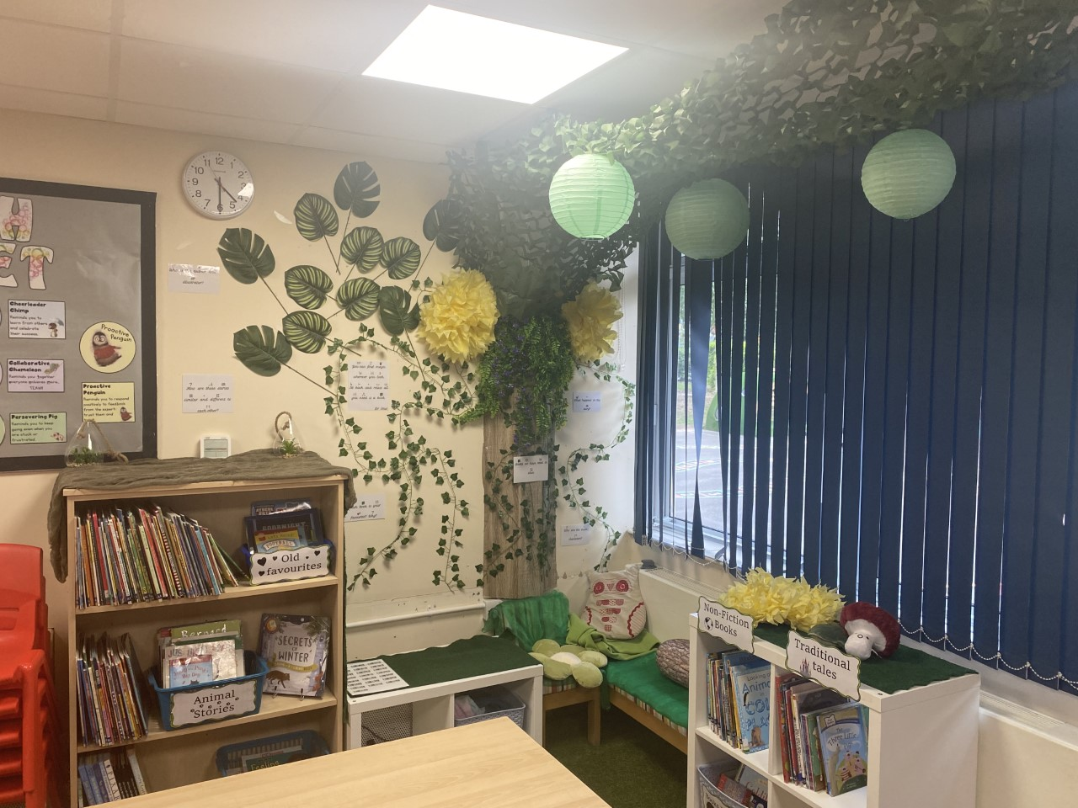
Reading for pleasure books…
Every year 1 classroom has a library of books the children are invited to borrow to enjoy for pleasure
The children have to scan the books in and out- just like a proper library
If the children do not return their books, they will not be permitted to take any more
Notes:
As well as their reading practice book, your children are invited to borrow books from their classroom library to read for pleasure.
As you can imagine, the logistics of 30 children scanning and borrowing library books is a world of fun so it is up to the class teacher as to how they choose to organise this the best way to suit their class. What I will say is that the children will encouraged to change their book REGULARLY. Certainly at least once a week.
I’m really keen for you to see the books that we do have to offer your children so after this final slide we’ll venture down into the classrooms so that you can share some reading time with your children and get a chance to see inside their new classroom.

Slide 22
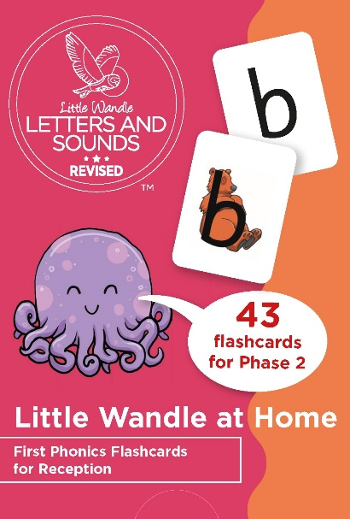
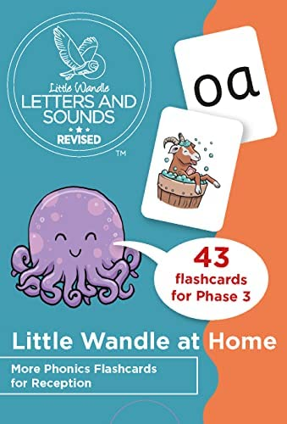
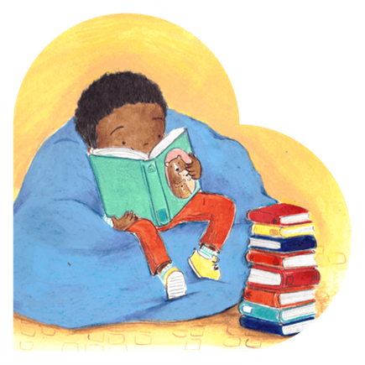
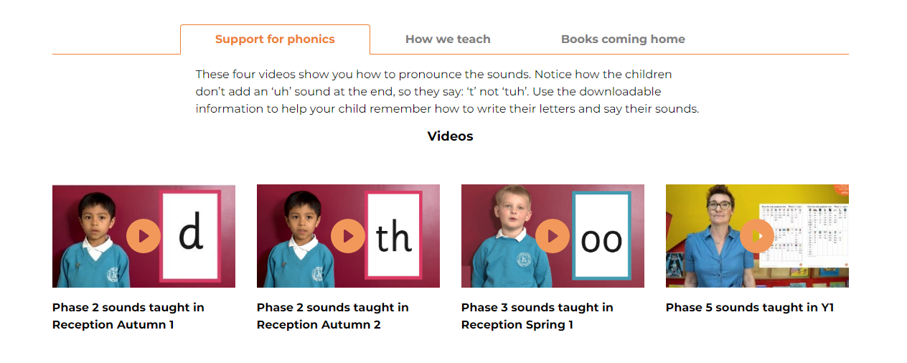
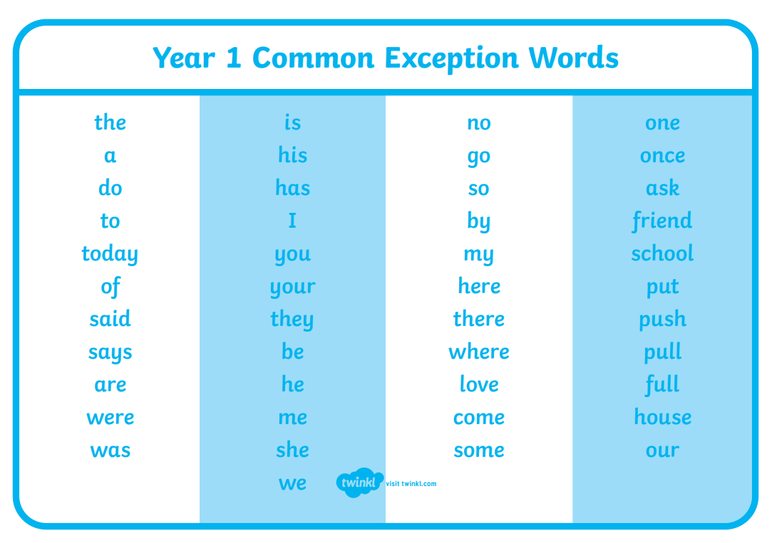
‘I want to help…’
If you wish…there are some resources available to purchase from Little Wandle to support practising at home
Encourage your children to read at home and remind them to change their reading for pleasure book regularly
There are lots of useful videos on their website to support parents & carers (find the link via our Oakridge Federation website)
Practise the ‘tricky’ words (sometimes called ‘common exception’ words)

Slide 23
A bit of housekeeping before we go…
The purpose of this morning is to chill and share some books
I’ve promised class teachers you’ll direct your questions my way so that they can focus their attention on their class
Please don’t take any photographs
Please ensure you make your way out by…

Slide 25
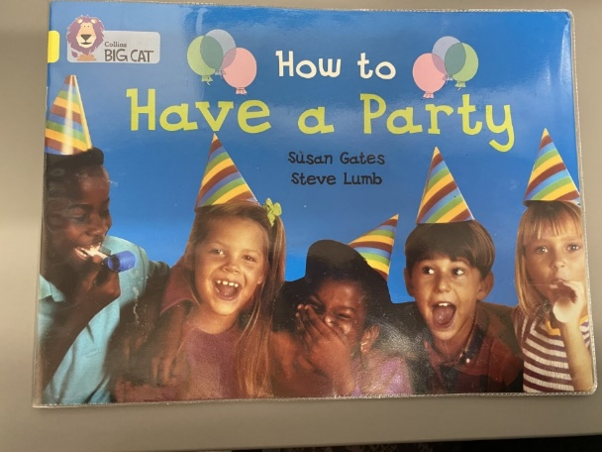
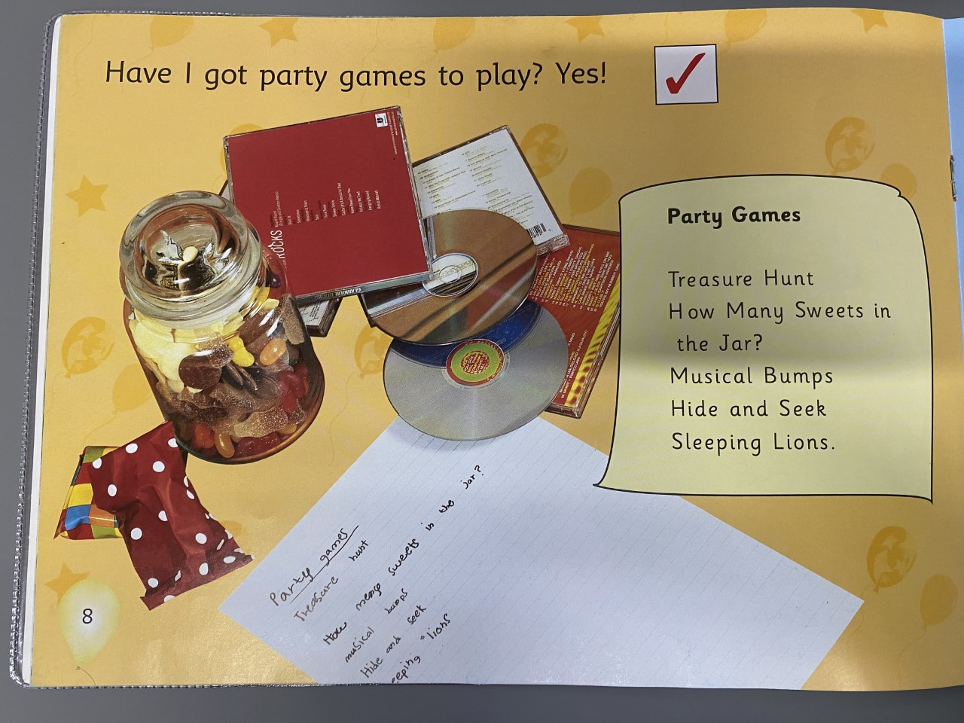
What about colour bands? OR
My child isn’t bringing enough books home
Notes:
Many of you who have had children go through the school in previous years, might be wondering ‘Why hasn’t my child brought home a colour band book?’
This is because in these earlier years, they do not allow the children to be successful in applying their phonics knowledge.
Here is a ‘yellow’ banded book, thought previously to be appropriate for a child in year R or the beginning of year 1. But there are at least 3 words in there which contain graphemes the children won’t come across for a little while yet.
Of course, children who are exposed to lots of books at home and are read to or read with regularly or simply just have a natural curiosity when it comes to reading, may well recognise these words in spite of their phonics learning, but what about the others?
Children who find reading hard anyway are just going to find it harder and are less likely to build confidence and ultimately an enjoyment of reading. Because why should they? There’s not even a picture of a lion on the page to help them work it out!

