Slide 1




Slide 2
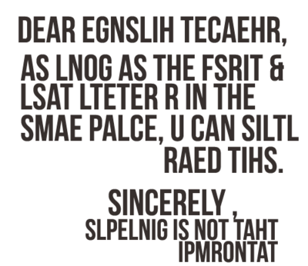

Slide 3
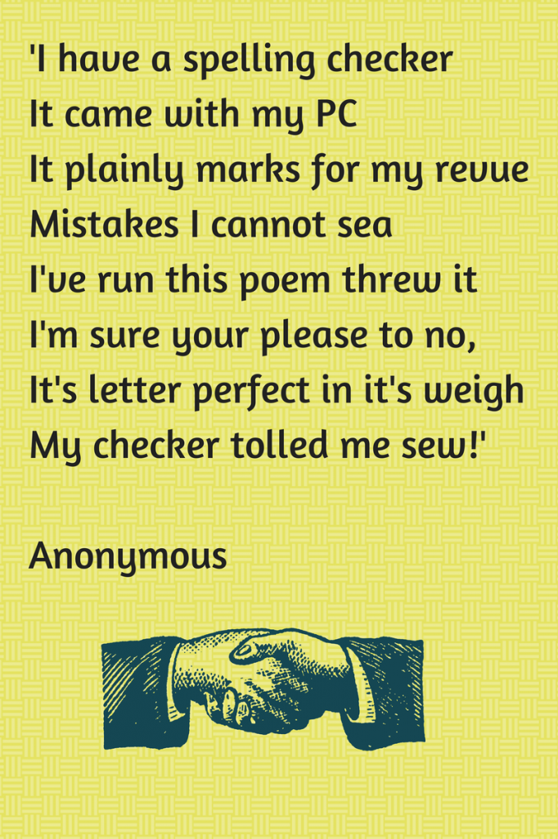

Slide 4









Slide 5


Children will not achieve age related expectations if they cannot spell

Slide 6




Have strategies for spelling unfamiliar words
Revisit spellings they have misspelt
Know how to use a dictionary
Build a bank of known spellings/sight words
Build CONFIDENCE

Slide 7

Regular spelling sessions every week
Range of hands on activities to practise and learn new spellings
Opportunity to edit and revisit misspelt words after writing

Slide 8


Slide 9



Fun
Enjoyable
Interesting

Slide 10
Year 1 and 2 common exception words
Statutory spelling list for year 3 & 4
Statutory spelling list for year 5 & 6

Slide 11

Children learn in different ways and this applies to spelling practise too. ..

Slide 12

Sounding out- segment the word and listen to the sounds
Syllabification- clap out and say each of the syllables
Analogy- making families of words
Root- e.g. bi (two) cycle (circle)
Prefixes and suffixes – dis-satisfied
Rules- ‘i before e except after c’
Sounding out words as they are spelt- e.g. Wed-nes-day
Words within words- there’s a ‘rat’ in ‘separate’
Mnemonics- Big elephants can’t always use small exits

Slide 13


Encourage children not to shy away from using a word just because they don’t know how to spell it- confidence is key! (‘dot it don’t dodge it!’)
Ensure spelling does not disrupt the writing process
Encourage children to consciously check and revisit incorrect spellings

Slide 14
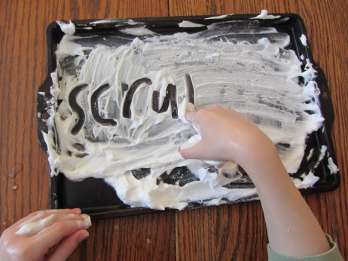
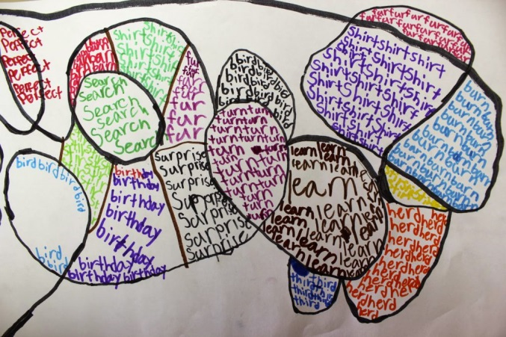


Practising spellings and exposing children to spellings at home as well as at school is so beneficial to their learning and development.
Be creative, have fun; the possibilities really are endless…

