Slide 1




Helping your child to read

Slide 2

What makes a good reader?
Can identify key words/phrases and ideas
Put these together to build meaning (gist)
Use their background knowledge
Visualise (characters, settings)
Generate inferences to develop the gist
Make predictions
Ask their own questions
Monitor meaning, using ‘repair strategies’

Slide 3

Top Tips!
Choose a quiet time
Set aside a quiet time with no distractions. 10 to 15 minutes is usually long enough.
2. Make reading enjoyable
3. Maintain the flow
If your child mispronounces a word, do not interrupt immediately. Instead, allow them to self correct. They may realise by the end of the sentence that they have said something incorrectly.

Slide 4
Top Tips!
4. Be positive
Boost your child’s confidence with constant praise for even the smallest achievement.
5. Success is the key
Don’t give texts which are too difficult. Give children the opportunity to build up their confidence. Struggling with a book with many unknown words is pointless; flow is lost, the text cannot be understood and children can easily become reluctant readers.

Slide 5
Top Tips!
6. Visit the library
Children can experience books they’ve never seen before and it can give them the chance to try out lots of new texts.
7. Regular practice
Try to read with your child on most days. Little and often is best. This can also be asking them questions. Reading aloud is an important skill for all children, no matter their ability.

Slide 6
Top Tips!
8. Talk about the books
There is more to being a good reader than just being able to read the words accurately. Give your opinion too and encourage children to explain their thinking and show evidence within the text.
9. Variety is important and all reading is good
Comics, magazines, football sticker books… Children need to experience a wide range of books!
10. Read favourites again and again
Encourage your child to re-read the books and poems they love as it helps to build fluency and confidence. Books and poems with rhymes and repeated words or phrases are great for getting your kids to join in and remember the words.

Slide 7
A starting point…
Get children to make predictions about the text, using just the front cover/blurb/images from the text
What do you think these images could be showing? What thoughts/ideas/feelings came into your mind when you saw the cover?
- Give children time to read aloud. Don’t stop and ask too many questions or you will disrupt their flow.

Slide 8
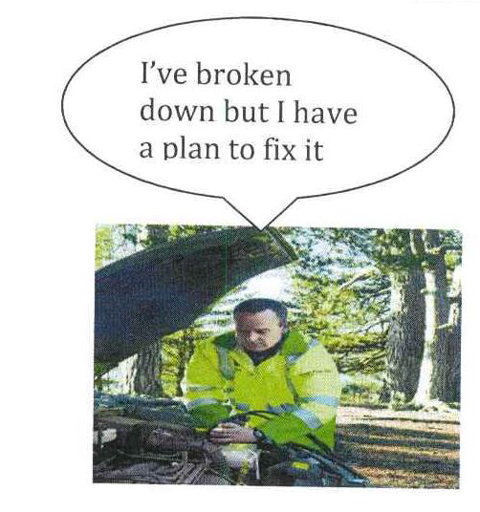

Good readers check that things make sense and watch out if it doesn’t.
Good readers use their background knowledge to connect with what they read
- Good readers check that things make sense, changing what they read as they go along

Slide 9

To check things make sense, it helps to…
Ask questions, including ‘I wonder…’
Make a picture
Make a picture
Stop if it doesn’t make sense!
Predict
Make a picture

Slide 10
Ask lots of questions…
Keep children interested with lots of different questions at opportune moments
Good readers need to develop their comprehension too!
Children can ask you questions too! Having them think of different questions will really challenge them.
 | is | did | can | would | will | might
Why
Who
What
Where
When
How

Slide 11
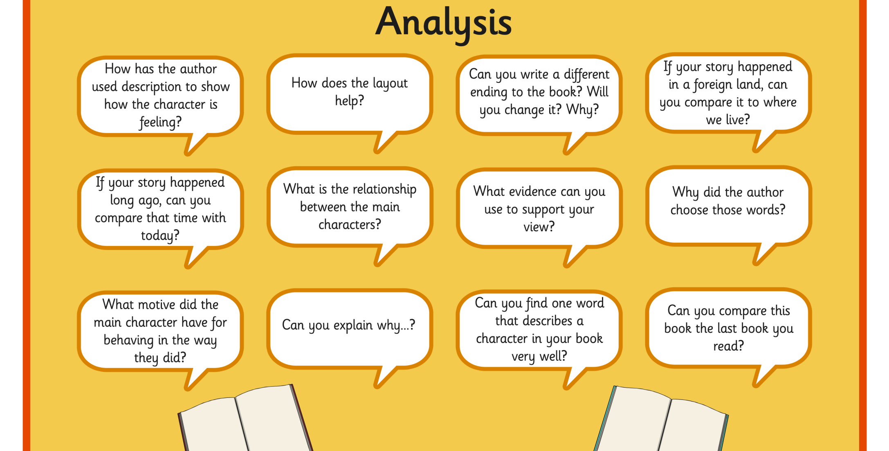

Slide 12
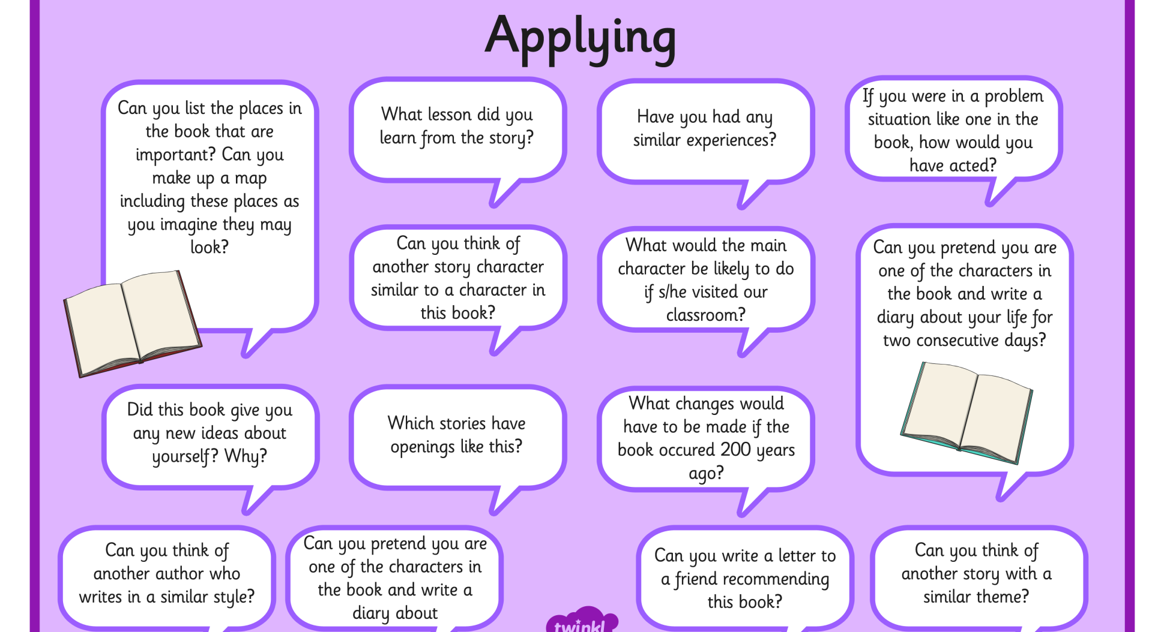


Slide 13
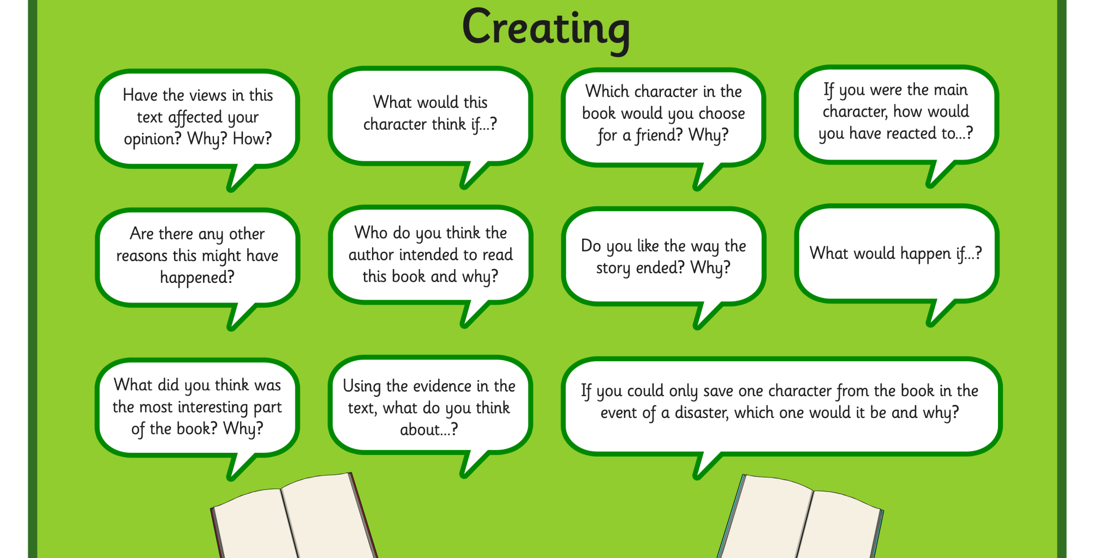

Slide 14
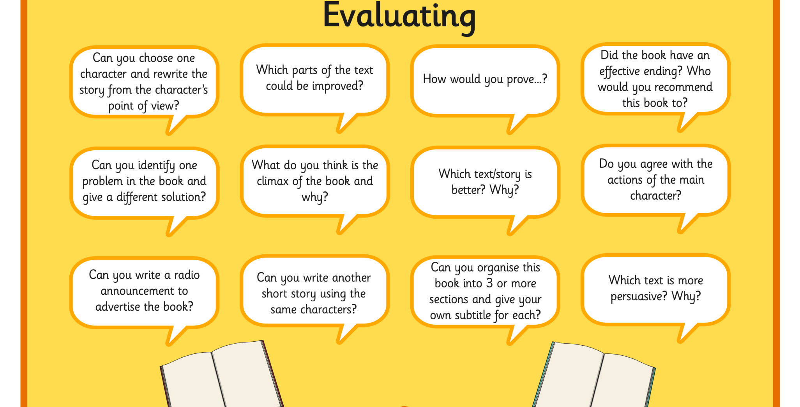

Slide 15
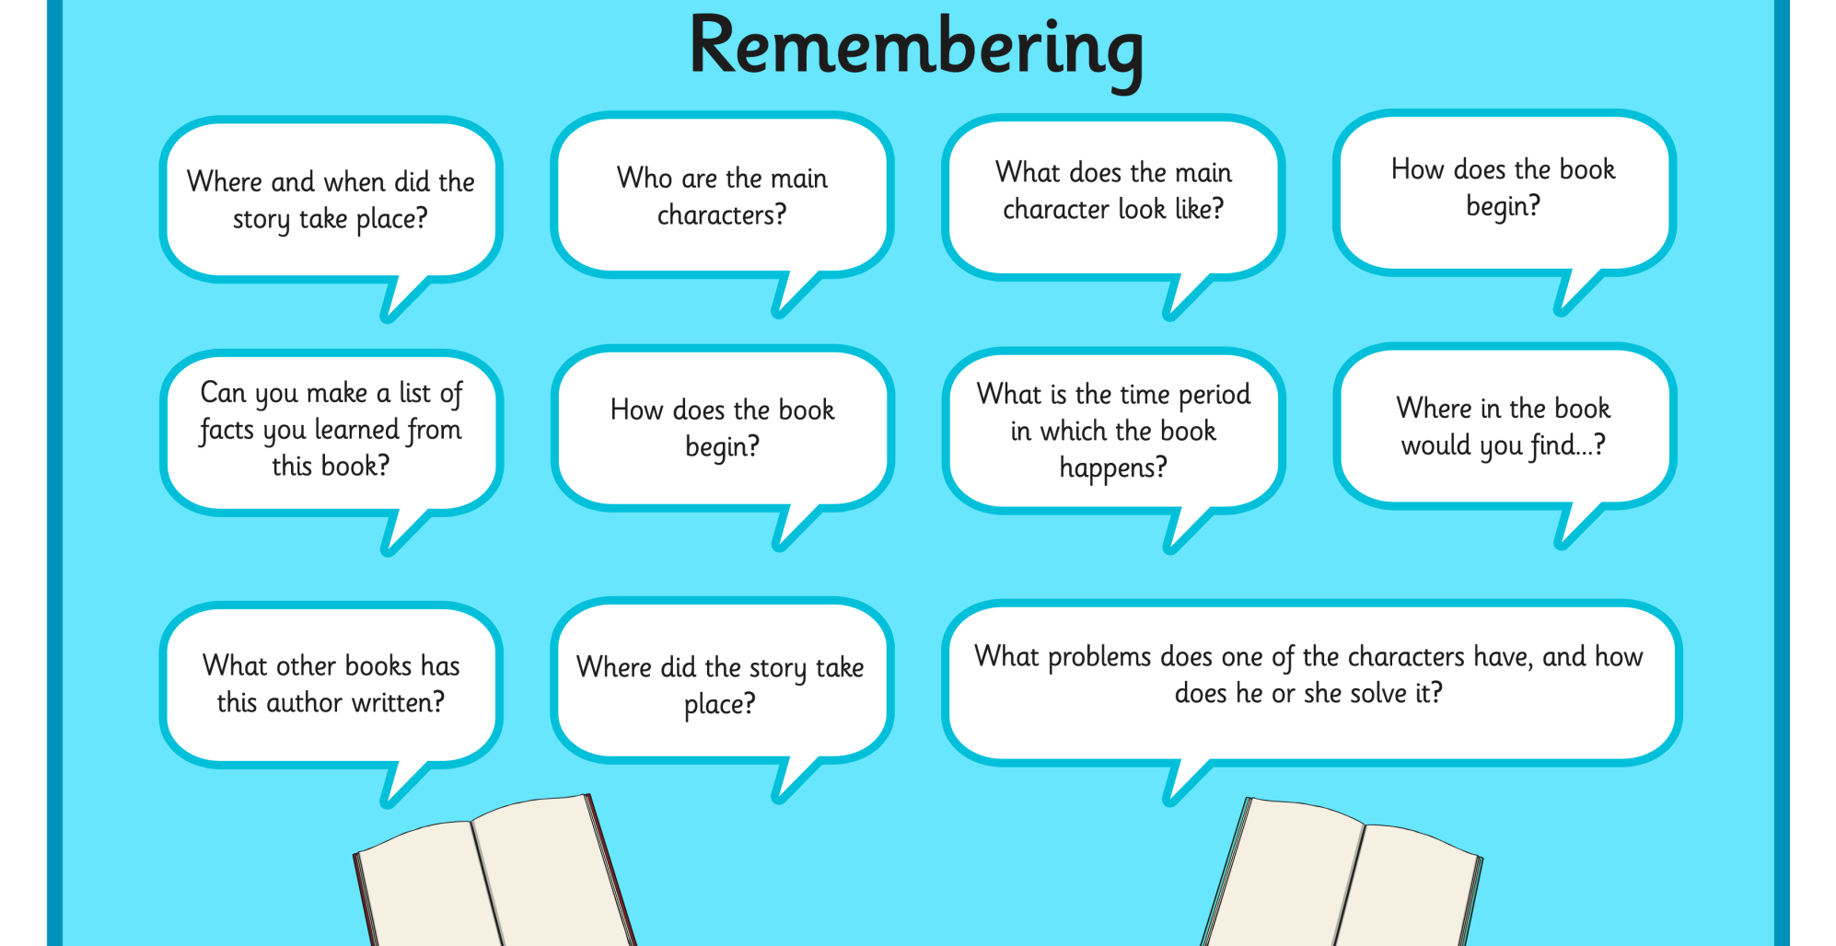

Slide 16
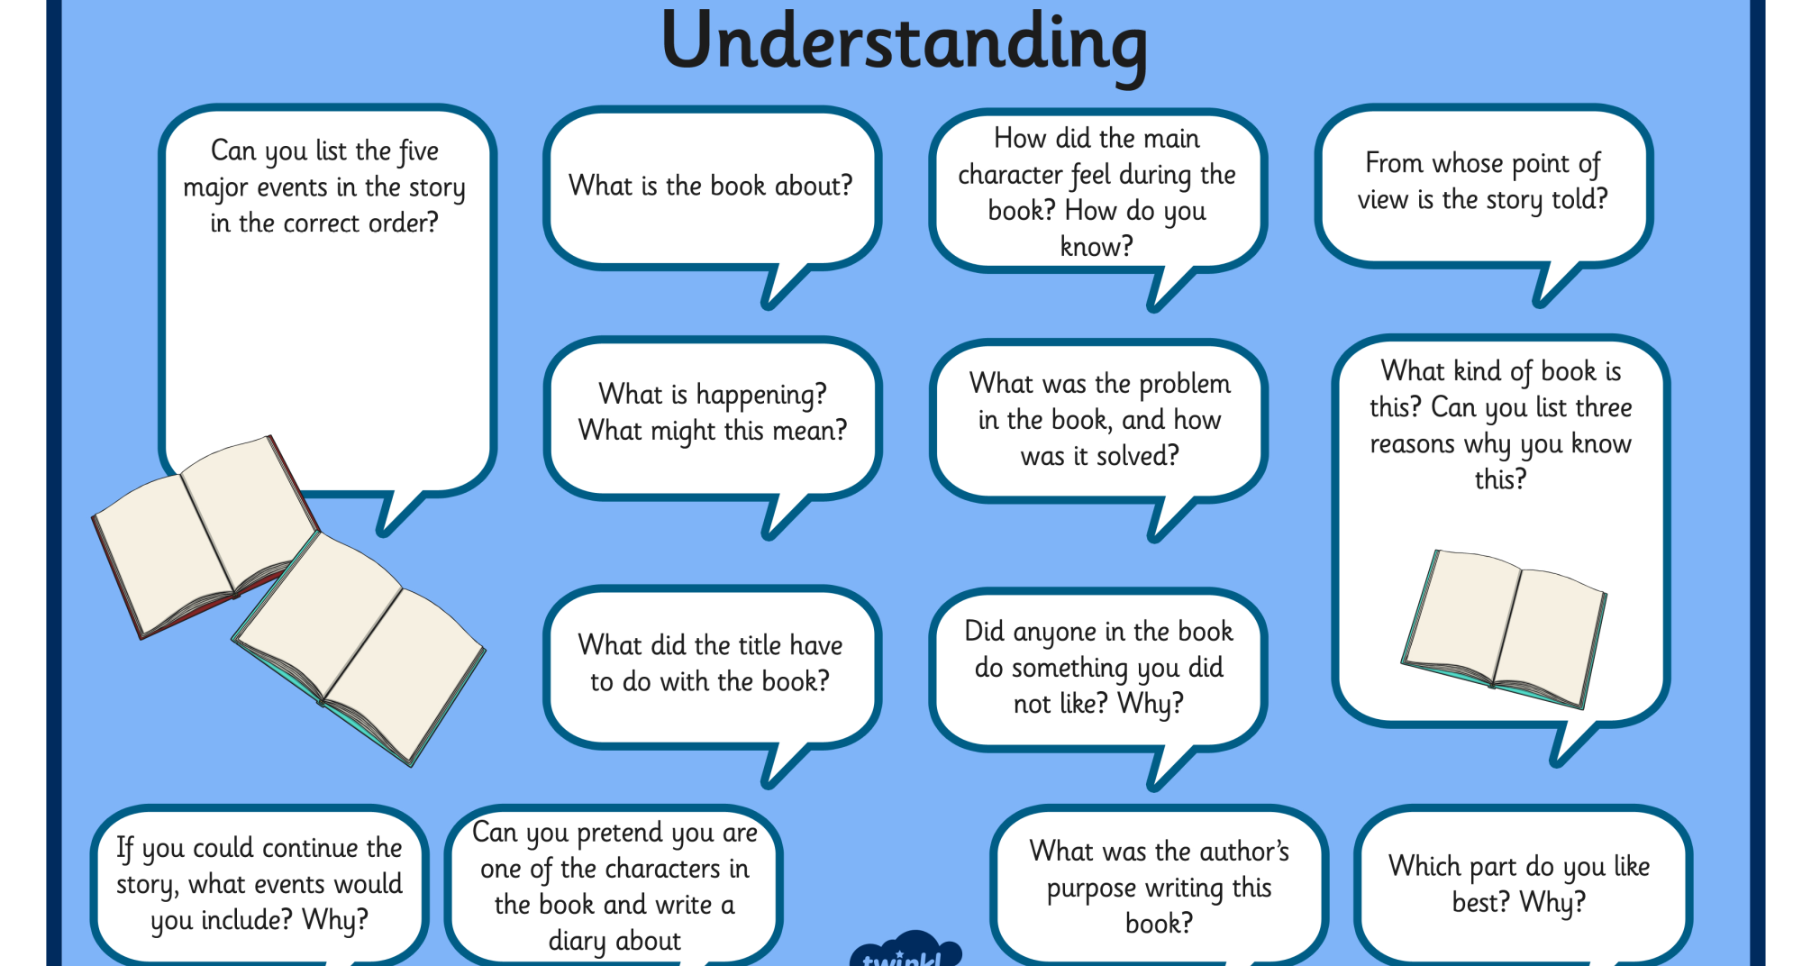

Slide 17
How can I help improve my child’s vocabulary?
Act out, provide props and images when reading a text, talking about new words
Go over any new words, checking children are able to explain their meanings
Introduce and use constantly, vocabulary at a much higher level than children are using in their own conversations

Slide 18
What should we expect from children?
Reading at the expected standard KS1:
https://www.youtube.com/watch?v=w4c_DMS-3IE
Reading at the expected standard KS2:
https://www.youtube.com/watch?v=fU0jRe5cnMw

