Slide 1

Parent Forum
Monday 16th January

Slide 2
Parent Forum
What is grammar and what are the expectations?
Examples from the new curriculum and our approach
Ways you can support your children at home
We have also provided a questionnaire for you to fill out regarding how we can further support you in this area

Slide 3

What is grammar?
Grammar allows us to express ourselves through language
Grammar is a key focus within the new curriculum
Children need to know much more complicated terms and their meanings, as well as apply this in a range of different ways

Slide 4
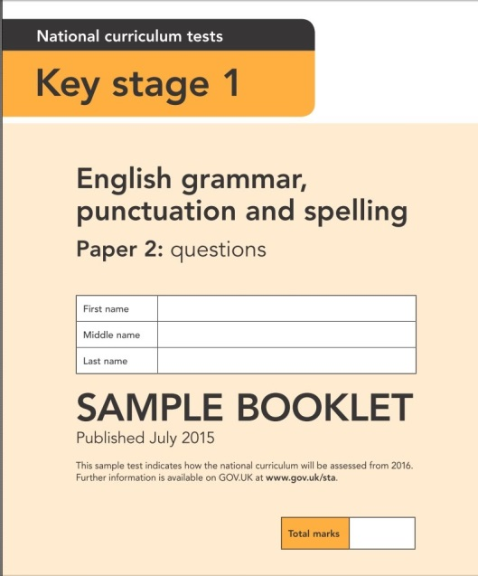
How is it assessed?
Writing is continually moderated and grammar is a key focus within all year groups
At the end of Year 2, there is a Spelling, Punctuation and Grammar test but this is not statutory
At the end of Year 6, there is a Spelling, Punctuation and Grammar test and these results are reported

Slide 5

Making children writers…
When writing, children need to think about a lot!
Where to write on the page
Their letter formation and handwriting
Spellings
Punctuation
Sentence structure
Grammar
How to improve their writing
The class success criteria
THEIR IDEAS!

Slide 6

Making children successful writers…
Grammar is important but we want to ensure we create imaginative and inspired writers who don’t write with a checklist but write with enjoyment!

Slide 7
Year 2 Assessment
Maximum of 45 minutes
It involves a lot of reading, particularly for multiple choice questions
There are over 20 different styles of questions to answer
Children may be supported with reading the question

Slide 8
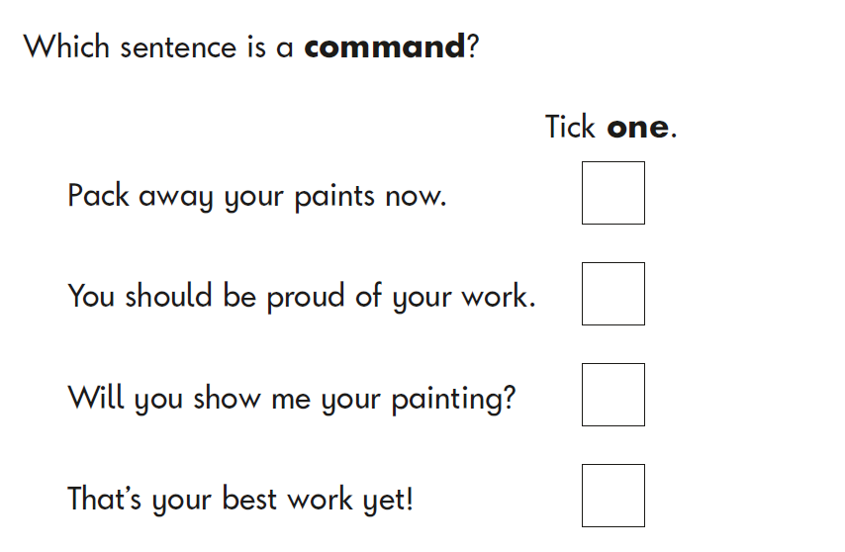
Some examples from the end of KS1 grammar test…

Slide 9
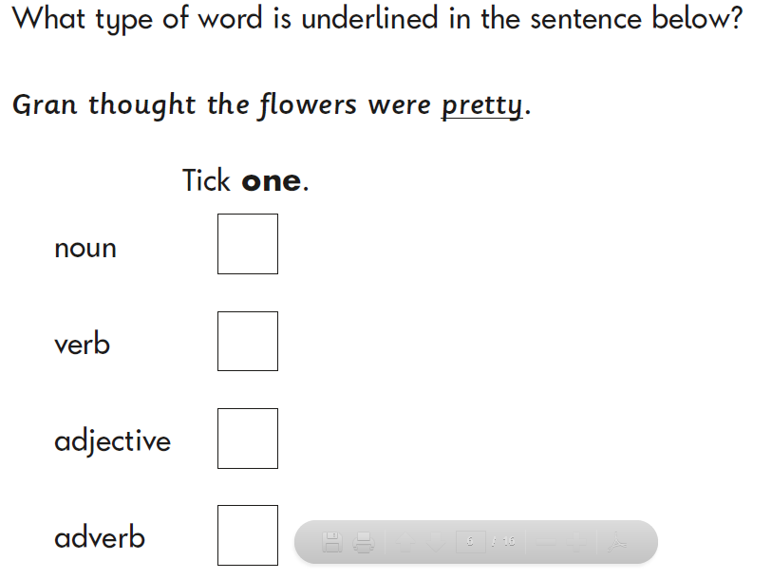

Slide 10
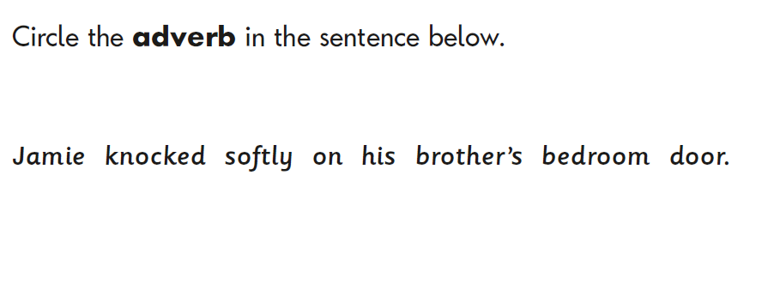

Slide 11
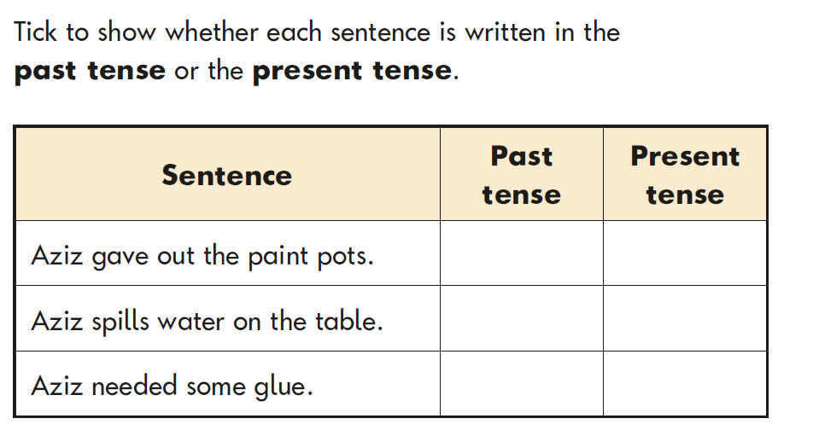

Slide 12
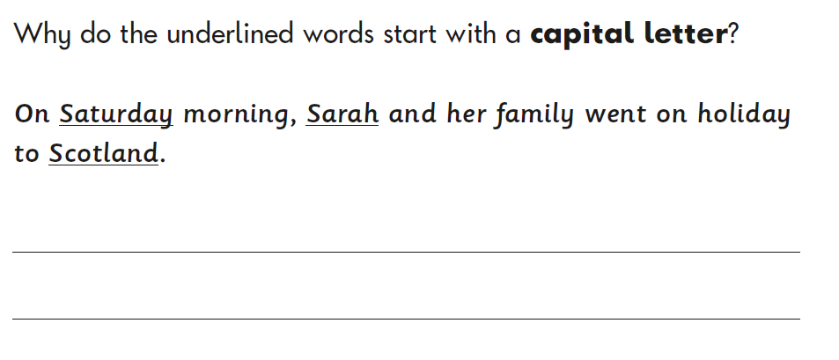
Some questions involve explanations too…

Slide 13
Year 6 Assessment
The test is 45 minutes.
Again, it involves a lot of reading (children can have support with this)
There are over 50 different styles of questions to answer.
It is made up of 2 parts:
- Spelling test
- Grammar test

Slide 14
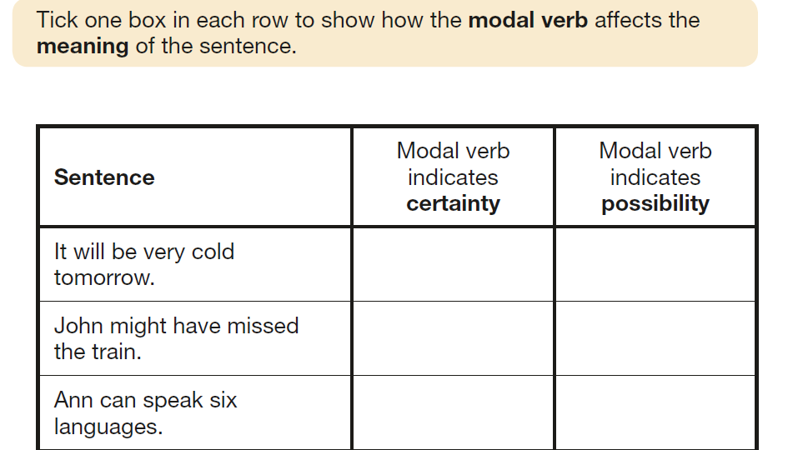
It’s not all nouns verbs and adjectives…

Slide 15
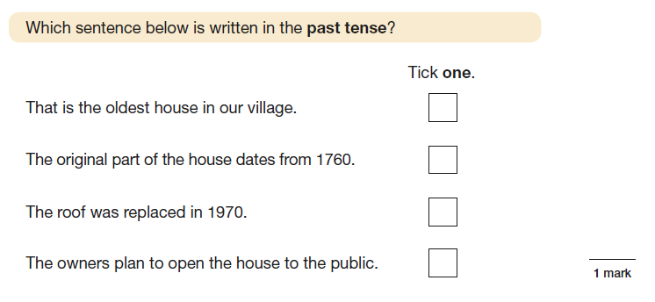
Knowledge and understanding has to be precise and secure…

Slide 16
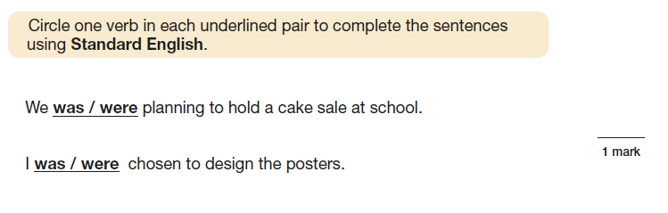
Understanding and use of Standard English is important; we try to model this as much as possible…

Slide 17
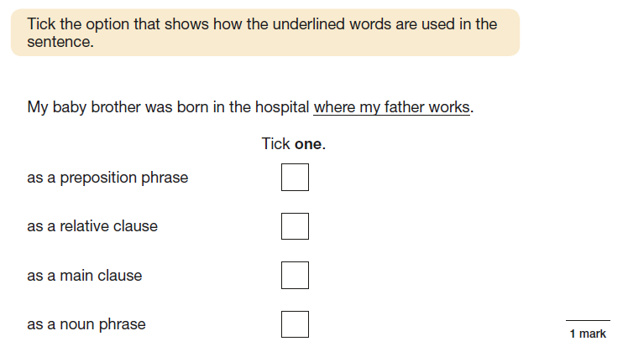
There’s more to it than meets the eye…

Slide 18
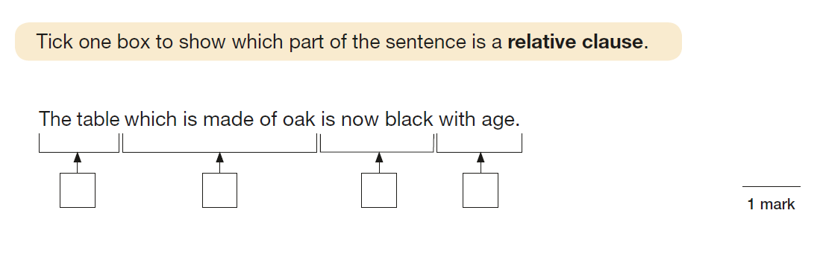
Children need specific knowledge of different types of clauses…

Slide 19
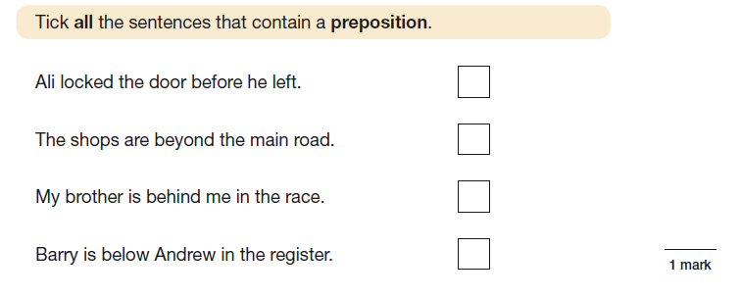
Many words have more than one function…

Slide 20

How can you support your children at home?

Slide 21

Vocabulary
Exposing children to new vocabulary is a brilliant way for you to support grammar teaching and learning at home
It doesn’t rely on expert subject knowledge- you might even learn together!
As well as enriching your child’s written and spoken language, it will support their grammatical understanding too…

Slide 22
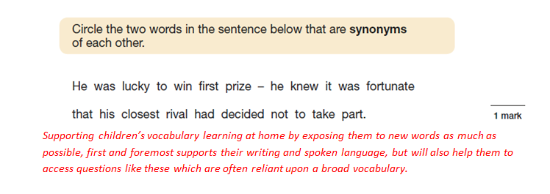
Many of the questions are reliant on a broader vocabulary…

Slide 23
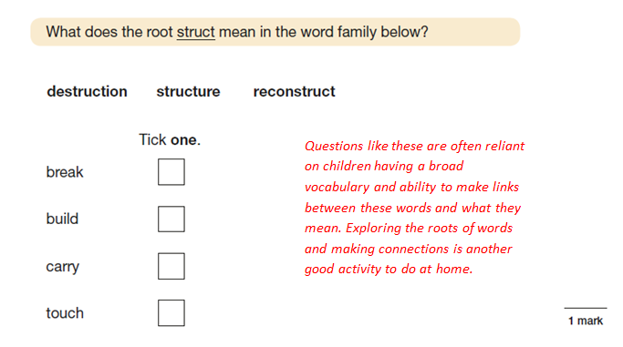
Explore vocabulary even further to spot connections…

Slide 24
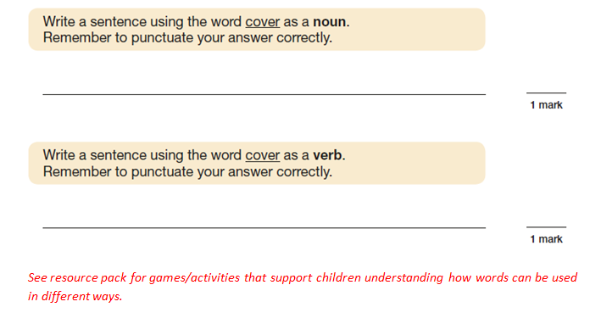
Explore how the same word can be used in different ways…

Slide 25

How to:
Talking, talk, talk
Don’t shy away from using words that might seem too big or too complex
Help children to understand what a new word means- even if this means looking it up together
Help them practise and use the new words they have learnt so that it becomes part of their own vocabulary

Slide 26
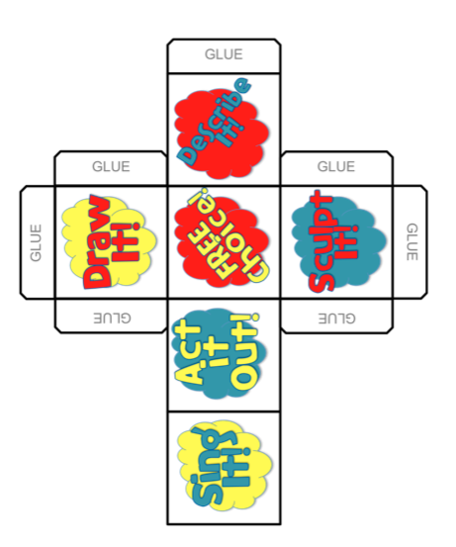
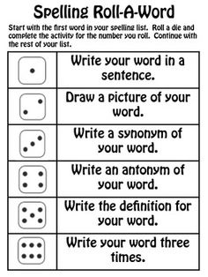
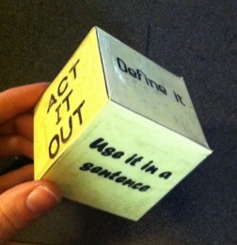

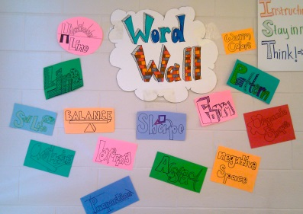

Slide 27
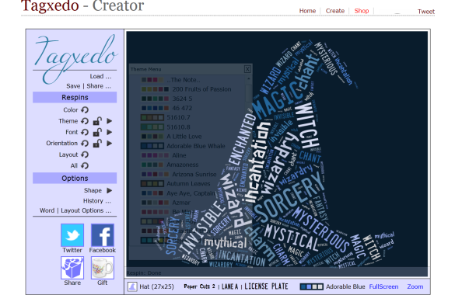

Slide 28
Some more resource ideas for use with your children…
Playdough punctuation- say sentence, child has to make appropriate punctuation for the sentence.
Antonym tennis- Player 1: Think of a word e.g. big
Player 2: think of the opposite e.g. small.
Continue until one player hesitates and can’t think of another word within 5 seconds. If this happens the other player wins a point.
Consequences– take it in turns to make a silly sentence using a noun, adjective or verb.

Slide 29
Synonyms for said (timed game - how many alternatives can you think of in 1 minute?)
Noun game- Say a noun. Child thinks of an appropriate adjective/verb to go with it. E.g. Kangaroo – jumping.
Websites:
http://www.bbc.co.uk/bitesize/ks2/english/spelling_grammar/
http://www.topmarks.co.uk/english-games/7-11-years/spelling-and-grammar

Slide 30
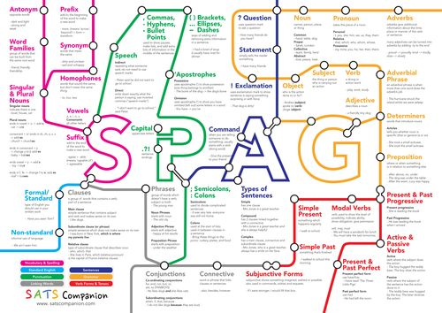
Helpful resources to support your own subject knowledge…

Slide 31
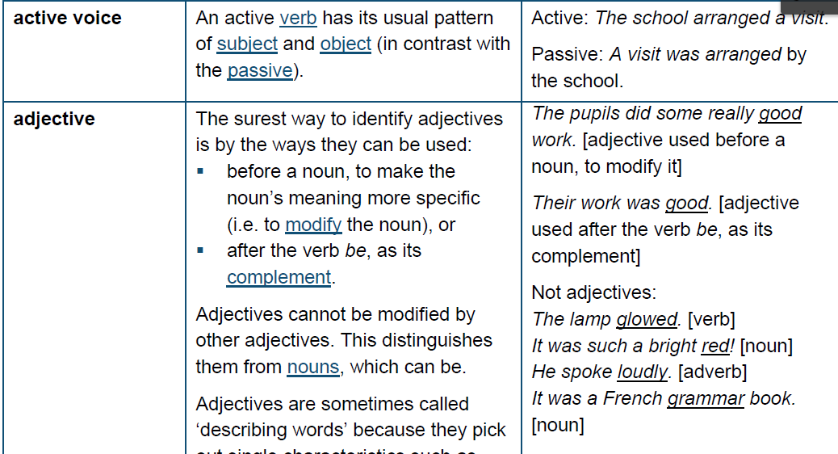
Glossary provided by the Government…
Glossary provided by the Government

Slide 32
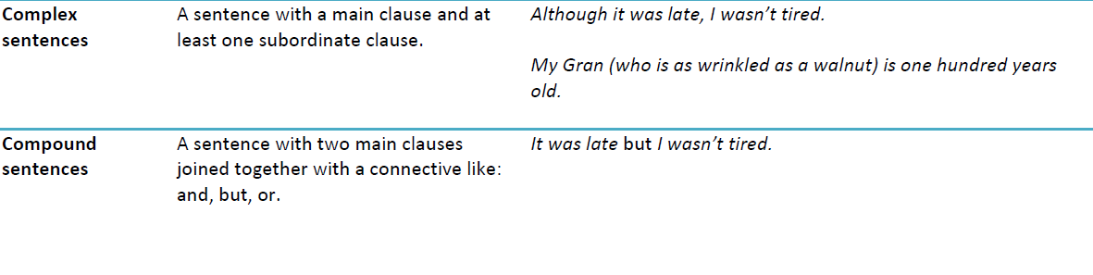
Alternatively…
Simplified glossary

Slide 33
Thank you
Any questions?
Questionnaire

