Slide 2
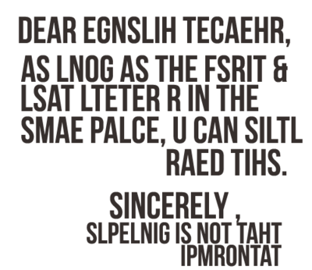

Slide 3
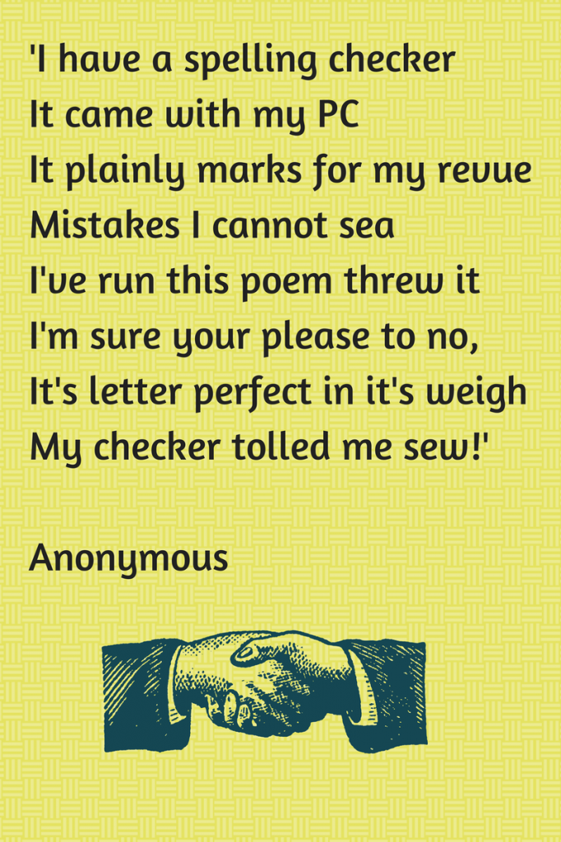

Slide 4
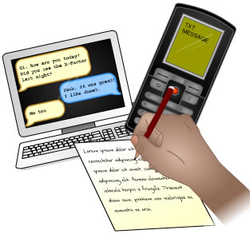

Slide 5
Children will not achieve age related expectations if they cannot spell

Slide 6
Have strategies for spelling unfamiliar words
Revisit spellings they have misspelt
Know how to use a dictionary
Build a bank of known spellings/sight words
Build CONFIDENCE

Slide 7
Regular spelling sessions every week to teach spelling patterns and strategies
Range of hands on activities to practise and learn spellings
Opportunity to edit and revisit misspelt words after writing
Spelling Bee incentive

Slide 9
Reinforce the strategies that are being learnt at school (i.e. spellings that are sent home as part of your child’s homework- this will vary from year group to year group)
Practise spelling the words your child will be expected to know by the end of the year (i.e. common exception words, year 3/4 statutory words or year 5/6 statutory words)

Slide 10
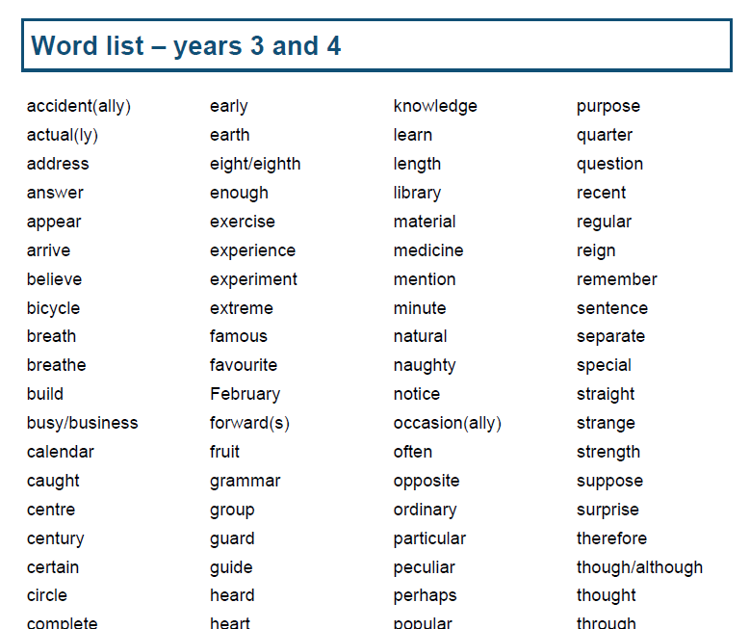
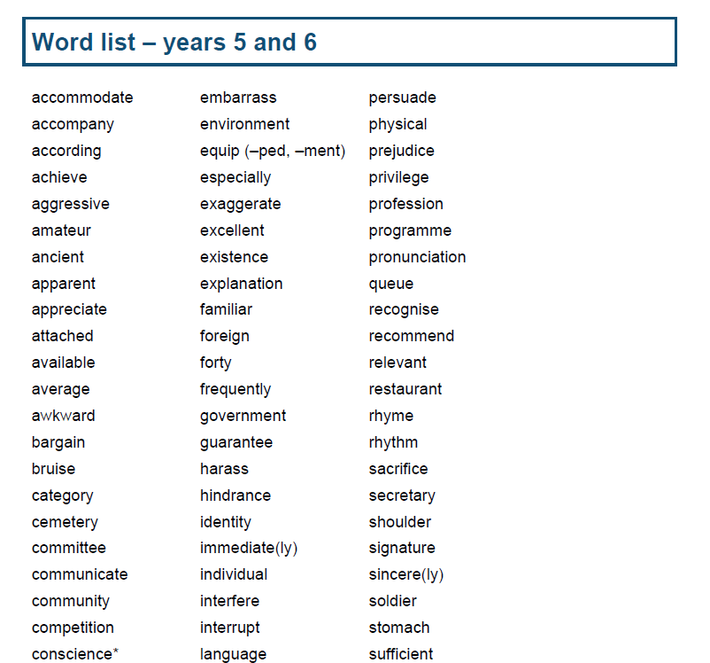
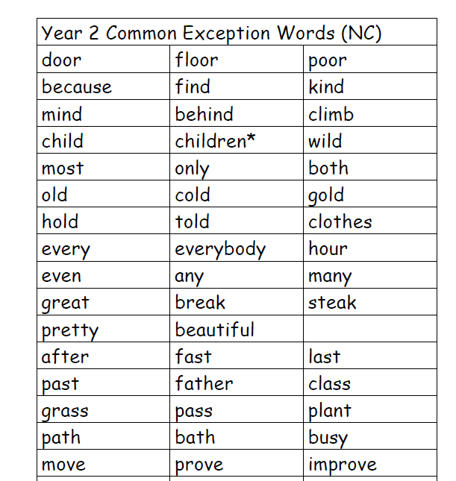

Slide 11
Year 1 and 2 common exception words
Statutory spelling list for year 3 & 4
Statutory spelling list for year 5 & 6

Slide 12
Fun
Enjoyable
Interesting

Slide 13
Children learn in different ways and this applies to spelling practise too. ..

Slide 14
Sounding out- segment the word and listen to the sounds
Syllabification- clap out and say each of the syllables
Analogy- making families of words
Root- e.g. bi (two) cycle (circle)
Prefixes and suffixes – dis-satisfied
Rules- ‘i before e except after c’
Sounding out words as they are spelt- e.g. Wed-nes-day
Words within words- there’s a ‘rat’ in ‘separate’
Mnemonics- Big elephants can’t always use small exits

Slide 15
Encourage children not to shy away from using a word just because they don’t know how to spell it- confidence is key! (‘dot it don’t dodge it!’)
Ensure spelling does not disrupt the writing process
Encourage children to consciously check and revisit incorrect spellings

Slide 16
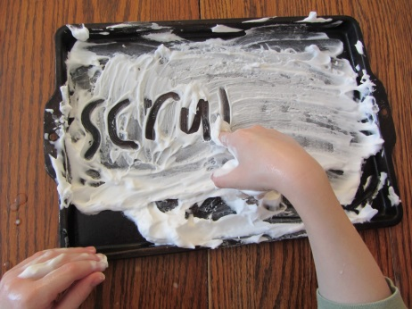
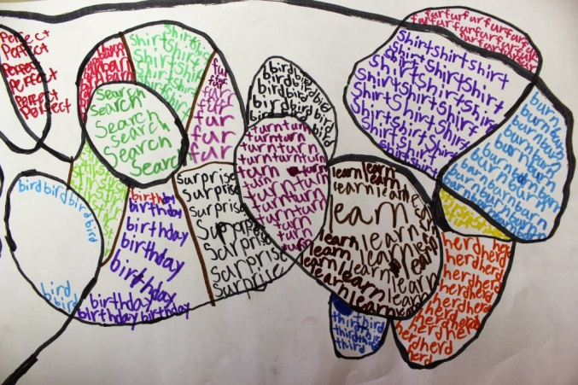
Practising spellings and exposing children to spellings at home as well as at school is so beneficial to their learning and development.
Be creative, have fun; the possibilities really are endless…

Slide 17
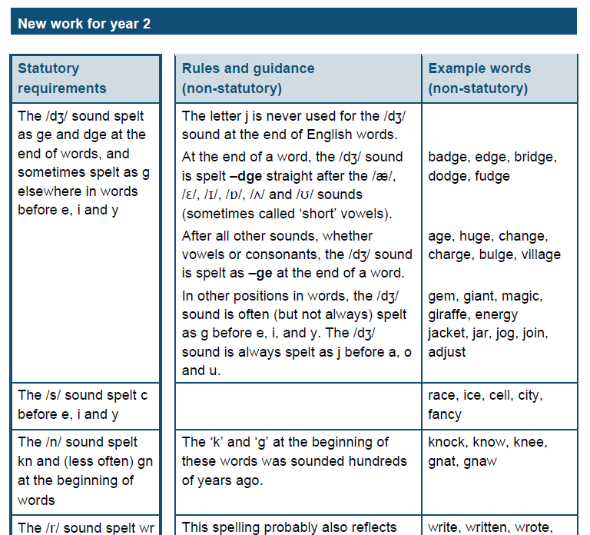
For those you wanting to take spelling at home a step further…

